Slide 1
RZ/G1 technical Seminar
OVERALL
Date: May 20, 2016
Name: RZG project
OA solution department
Renesas Electronics Corporation

Slide 2
Copyright (1/2)
© 2010-2015 Renesas Electronics Corporation. All rights reserved.
License: Unknown! FIXME.
This document reused:
RENESAS’s confidential documents
http://free-electrons.com/doc/training/embedded-linux/embedded-linux-slides.pdf
License: Creative Commons Attribution - Share Alike 3.0 - http://creativecommons.org/licenses/by-sa/3.0
http://www.denx.de/wiki/publish/U-Bootdoc/U-Bootdoc.pdf
License: GPLv2 - https://www.gnu.org/licenses/old-licenses/gpl-2.0.en.html
Documents of Yocto project - http://www.yoctoproject.org
License: Creative Commons Attribution - Share Alike 2.0 (compatible with Creative Commons Attribution - Share Alike 3.0) - http://creativecommons.org/licenses/by-sa/2.0

Slide 3
Copyright (2/2)
Documents of Qt
License: GNU Free Documentation License - http://www.gnu.org/licenses/fdl.html
http://www.busybox.net/BusyBox.html
License: GPLv2 - https://www.gnu.org/licenses/old-licenses/gpl-2.0.en.html
https://en.wikipedia.org
License: Creative Commons Attribution - Share Alike 3.0 - http://creativecommons.org/licenses/by-sa/3.0

Slide 4
About
Training content will be separated to 2 parts: Basic information & knowledge and Advance & Deeper Technical knowledge
Basic information & knowledge: Encapsulates the basic information needed in most 2 days training for FAE/AE.
Overall Information: Provides the most intuitive information about concepts and theory relate to RZG platform.
Function: Provide the features, functionalities of the difference BSP & demonstrations on RZG.
Advance & Deeper Technical knowledge: Additional knowledge and information for Development/Technical Engineer
Embedded Linux & Development environment
RZG BSP Features & Development
Yocto build System with RZG
RZ/G Graphics and Multimedia Package
GStreamer & Qt framework Architechture

Slide 5
Agenda (1/2)
Basic information & knowledge
Training Content
Hardware requirement & configuration
Linux & Development environment
RZG Overall Picture
Yocto build System & Renesas BSP
Practice: Yocto Building
GStreamer
Practice: GStreamer pipeline
Qt framework
Demonstrations & Features
Practice: Setup & Run Demonstrations

Slide 6
Agenda (2/2)
Advance & Deeper Technical knowledge
Embedded Linux & Development environment
RZG BSP Features & Development
Detail Yocto build System
RZ/G Graphics and Multimedia Package
GStreamer & MMPOC Development
Qt Framework and Overall Picture

Slide 7
Training content
Goal
FAE/AE members can get familiar with RZ/G SW platform in BSP, MMPKG, MMPOC, and Qt.
Time table
 | Day 01 | Day 02 | Day 03
9:00-12:00 | Hardware requirement & configuration Linux & Development environment RZG Overall Picture | GStreamer Practice: Setup & Run GStreamer | Qt Demonstrations: Introduction & Demo Doorphone Demonstrations. Practice: Setup & Run Demonstrations
12:00-13:00 | LUNCH
13:00-17:00 | BSP & Yocto build System Practice: Yocto Building | Qt framework HMI: Introduction & Demo. | F2F Technical Discussion.

Slide 8
Agenda
Basic information & knowledge
Training Content
Hardware requirement & configuration
Linux & Development environment
RZG Overall Picture
Yocto build System & Renesas BSP
Practice: Yocto Building
GStreamer
Practice: GStreamer pipeline
Qt framework
Demonstrations & Features
Practice: Setup & Run Demonstrations

Slide 9

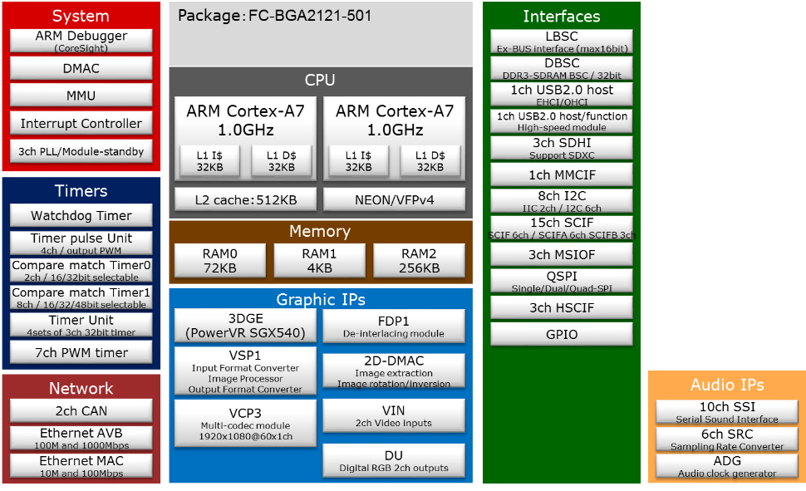
RZ/G1E (R8A77450) Block Diagram
Power supply voltage (typ.)
1.8 V: (ETM, SD, LVCMOS I/F,
Xtal, JTAG, Trace and RST)
1.0 V: (core)
1.5 V: (DDR3-I/O
SSTL Mode:DDR3)
3.3 V: (Others)
Notes:
RZ/G1Eの機能を色分けした図です。ここからE, M, Mと見えにくい図でますが, Webに同じ絵を掲しておりますので, そちらで確認ください。ここでは割愛させていただきます。
SGX540:

Slide 10
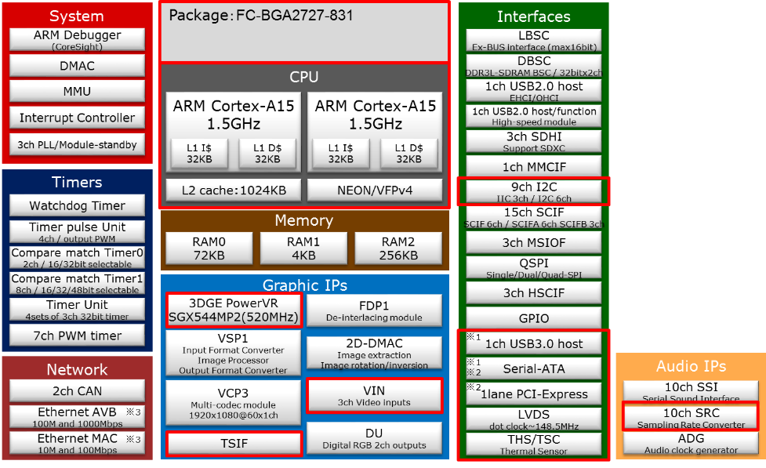
RZ/G1M (R8A77430) Block Diagram
*1：It becomes the choice of function of either USB3.0 or SATA0 because PHY is used for two purposes.
*2：It becomes the choice of function of either PCI-e or SATA1 because PHY is used for two purposes.
*3 : It becomes the choice of function of either Ethernet MAC or Ethernet AVB because pin-multiplex.
Power supply voltage (typ.)
1.8 V: (ETM, SD, LVCMOS I/F, Xtal, JTAG, Trace and RST)
1.03 V: (core, SATA, PCI Express, USB3.0)
1.35 V: (DDR3-I/O SSTL Mode:DDR3L)
3.3 V: (Others)
The difference between
RZ/G1E and RZ/G1M

Slide 11
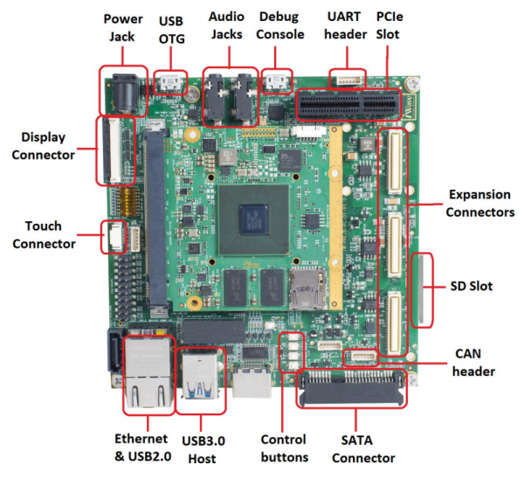
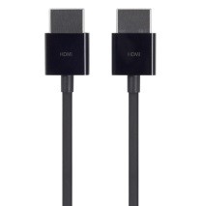
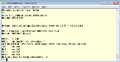

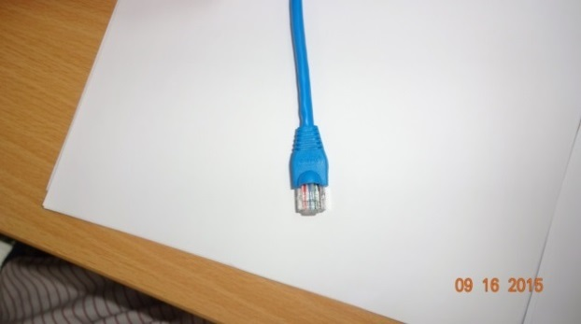
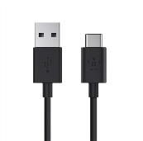
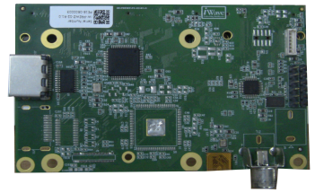
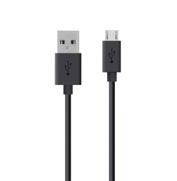

HARDWARE REQUIREMENT & CONFIGURATION
Linux PC
Windows PC
IP: 192.168.5.1
USB cable
HDMI Screen
HDMI cable
IP: 192.168.5.20
Ethernet cable

Slide 12
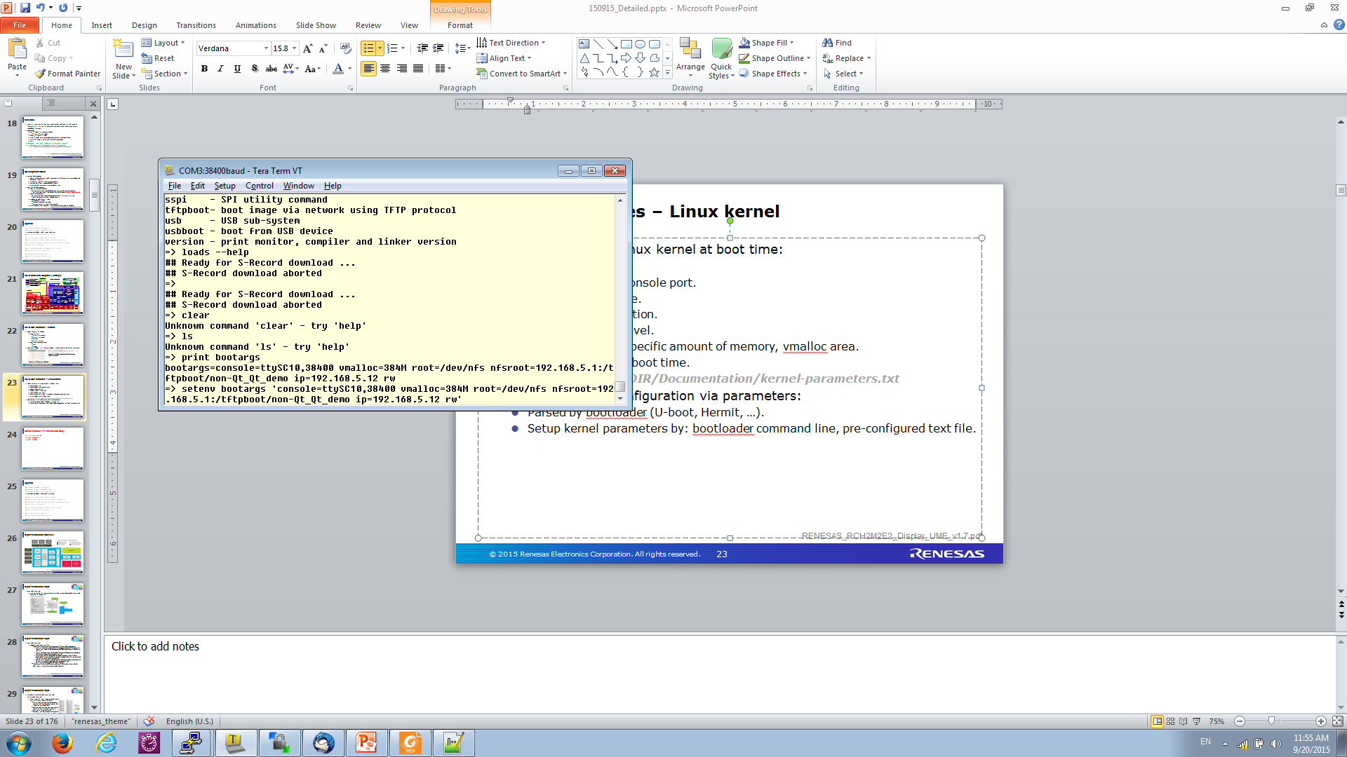
HARDWARE REQUIREMENT & CONFIGURATION
Windows PC: Use for control Dev board by command line through terminal
Terminal: Use SW Tera Term
Communication: Serial (USB – micro USB)
Driver Requirement on PC: FT232R driver (http://www.usb-drivers.org/ft232r-usb-uart-driver.html)
Useful functions:
Input parameter for Board before start System: Setup CMA-1 size, setup debug log console port, choose boot device, choose rootfs (OS & utilities) location, force usage of a specific amount of memory, vmalloc area, print debug log at boot time.
Control Dev board when log-in the Linux Operation System: Editor (vi, vim), run script, run demonstrations, run multimedia command line/tools.
Windows PC
Example of setting kernel parameters by command line of u-boot.

Slide 13





HARDWARE REQUIREMENT & CONFIGURATION
Linux PC: Can use the stand-alone Linux PC or use The Virtual Linux OS on Windows PC
Windows PC
Virtual Linux
Linux PC

Slide 14
HARDWARE REQUIREMENT & CONFIGURATION
Linux PC: Use for build System for board & copy System on board
Protocol: ssh, scp,…
Communication: Ethernet Lan (Need setup IP board & PC at same class)
Build system: Yocto
Output of Yocto build system will be downloaded to board: uImage (kernel), uImage-r8a7743-iwg20m_q7.dtb (Device tree blod), core-image-weston-iwg20m.tar.bz2 (rootfs - System file, library, demonstrations, …)

Slide 15
Agenda
Basic information & knowledge
Training Content
Hardware requirement & configuration
Linux for Development
RZG Overall Picture
Yocto build System & Renesas BSP
Practice: Yocto Building
GStreamer
Practice: GStreamer pipeline
Qt framework
Demonstrations & Features
Practice: Setup & Run Demonstrations

Slide 16
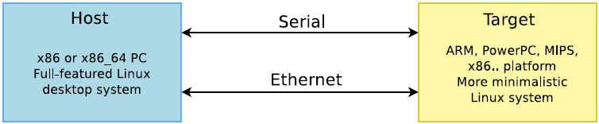
LinuX FOR DEVELOPMENT
http://free-electrons.com/doc/training/embedded-linux/embedded-linux-slides.pdf
OS for Linux development: Ubuntu - widely used and easy to use
Root and non-root users
S/W packages (.deb) and Managing them (sudo apt-get or apt-cache)
Host vs. Target
Serial line communication program: Minicom (Linux) or Teraterm (Windows)
Command line for text editor (Linux): vi or vim
Notes:
OS for Linux Dev: In the current RVC use Ubuntu LTSI 14.04 x64
You need root privilege to install necessary software for building & compiling process, during run building/compiling tool/sw, you just need the non-root privilege user.
Communication between Host & Target:
+ Serial: interact (writing command, reading messages, …) with terminal through target board console interface
+ Network: May use the ssh protocol to interact or communicate with target board
- Minicom & Teraterm is 2 genera software for serial line communication purpose.

Slide 17
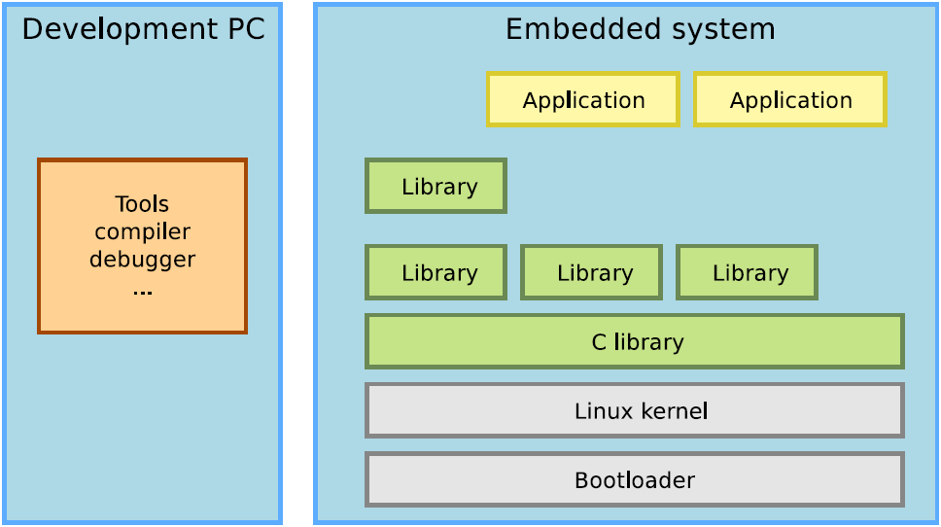
Global architecture
Explanation about Embedded Linux
http://free-electrons.com/doc/training/embedded-linux/embedded-linux-slides.pdf
User Space
Kernel Space
Notes:
- Development PC: Describe simply just for the cross compiling purposes (The more complicate in fact)
- Embedded System:
+ C library: is known as glibc (GNU C library) in Linux
+ In kernel sapce: It will include many more componet like System call interface to communicate with the C library from user space, Kernel subsystem, software protocols support, device drivers, …

Slide 18
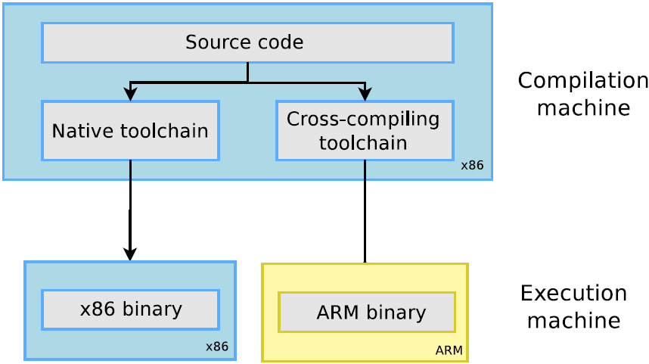
Cross-compiling toolchains
http://free-electrons.com/doc/training/embedded-linux/embedded-linux-slides.pdf
There are 2 method for Building source code on linux: use Native toolchain and use Cross-compiling toolchain
Cross-compiling Toolchain: Compile on one machine (Linux PC x86) and run on the other machine (ARM SOC)
Native toolchain: Compile and run directly on the current machine (ex: Linux PC x86)

Slide 19
Agenda
Basic information & knowledge
Training Content
Hardware requirement & configuration
Linux & Development environment
RZG Overall Picture
Yocto build System & Renesas BSP
Practice: Yocto Building
GStreamer
Practice: GStreamer pipeline
Qt framework
Demonstrations & Features
Practice: Setup & Run Demonstrations

Slide 20
RZG Overall picture
App-
lication
Linux Application
Qt Application
Library/Binary/
Guarantee
Qt framework
Middle-
ware
Reference driver・Library
/Source/No guarantee
Multimedia Package
Licensed
GStreamer
Reference driver
/Source/No Guarantee
Plugin
*Offer from ASI
OS user I/F
Mem
Mgr.
I/F
FDP
Mgr.
I/F
VSP
Mgr.
I/F
OMX
Open
GL
ES
UVCS
LinuxBSP
No fee/No guarantee
VCP Codec Middle
OS Kernel
V4L2
Capture
DRM/
KMS
FB
dev
FDP
Mgr.
VSP Mgr.
S3C
drv.
Mem
Mgr.
UVCS
drv.
VCP
drv.
SGX
drv.
OnBoard
drv.
Onchip
Periph
drv.
ALSA
Core/SSI
drv.
VIN drv.
DU
drv.
FDP
drv.
VSP
drv.
2D
DMAC
drv.
RZ/G series LSI
Evaluation
Board
Onboard
Device
Onchip Periph
SSI
VIN
VSPD
S3C
FDP
VSPS
2D
DMAC
VCP/
VPC
SGX
DMAC
DU
Notes:
Question: Application ? Software

Slide 21
RZG Overall picture
Multimedia Apps/Tool
GStreamer Applications:
Case Video Playback
GStreamer Framework
Gst-omx plugins
(omxh264dec)
Gst plugins base
(vspmfilter)
Gst plugins bad
(waylandsink)
SW
User Space
Wayland/Weston
OMX Video
VSP Mgr I/F
DRM/KMS
Kernel Space
VCP Drv.
VSP Mgr.
DU/VSPD Drv.
HW
HW IP
VCP3
VSP
VSPD
DU

Slide 22
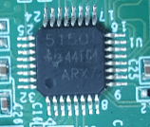
RZG Overall picture
Multimedia Apps/Tool
GStreamer Applications:
Case Capture Video
GStreamer Framework
Gst plugins good
(v4l2src)
Gst plugins base
(vspmfilter)
Gst-omx plugin
(omxh264enc)
SW
User Space
V4L2 I/F
VSP Mgr I/F
OMX Lib I/F
Kernel Space
V4L2 Drv.
VSP Mgr.
UVCS Drv.
Camera
HW
HW IP
VIN
VSP
VCP
5150
TVP5150

Slide 23
RZG Overall picture
Qt Apps/Tool
Qt Applications:
Qt Framework
GStreamer Framework
SW
User Space
Gst plugins
(Gst-omx plugin, gst plugin base/bad/good, ..)
V4l2,VSP,… I/F
OMX Lib I/F
Wayland/Weston
…
Opengl ES
Kernel Space
V4L2 Drv.
VSP Mgr.
DU/VSPD Drv.
…
SGX Drv.
HW
HW IP
VIN
VSP
VSPD
…
SGX
DU

Slide 24
RZG Overall picture
Kernel Space
Video Cap Drv.
VSP Mgr.
DU/VSPD Drv.
…
SGX Drv.
RZG BSP:
Concept: All of Package in Kernel Space support board enable the features on available HW IP in SOC.
List of Component: UVCS Lib, H264 Dec Lib, Memory manager, S3CTL Drv., FDP Manager, FDP Driver, V4L2 Driver, DRM/KMS Driver, VSP Manager, 2DDMAC Drv., GFX Drv., …
BSP v1.0
BSP v1.5
BSP v2.0
User space application
User space application
New feature supported
User space application
Driver supported features
Driver supported features
Driver supported features
Hardware features
Hardware features
Hardware features

Slide 25
RZG Overall picture
Build System:
Concept: Build All SoftWare packages in both of User Space & Kernel Space (Include BSP, Driver I/F lib, Middle/Multimedia Lib, Application/Demonstrations, …
Tool support: Yocto Project
Requirement: Linux PC (Ubuntu x86)

Slide 26
Agenda
Basic information & knowledge
Training Content
Hardware requirement & configuration
Linux & Development environment
RZG Overall Picture
Yocto build System & Renesas BSP
Practice: Yocto Building
GStreamer
Practice: GStreamer pipeline
Qt framework
Demonstrations & Features
Practice: Setup & Run Demonstrations

Slide 27
Yocto
http://www.yoctoproject.org/docs/current/yocto-project-qs/yocto-project-qs.html
What is Yocto ?
A building system with pre-configured setting to support building from scratch Linux system.
Why Yocto?
Reduce significantly workload of configuring to build and preparing dependencies.
Manual build
Yocto build
Run configure of package A
Download pre-configured recipes
Enough dependencies?
N
This take only 4 – 8 hours to build whole image (~3000 – 5000 package)
Download pre-configured machine setting
Download dependencies
could take whole day to build 1 package
Y
Choose advanced options to modify target image
Correct options
N
Configure options
Start building
Y
Start building

Slide 28
Renesas Yocto Build system – Overview
Licensed Binary
(OpenGL/ES e.g.)
Open Source Pjs.
Licensed Products From REL.
Src. of
Pkgs.
Src. of
REL BSP
Recipe
For
Products
Proprietary, Licensed
Binaries for Userland
Secure Domain
Secure Boot binary
RT Domain
Secure OS
from 3rd party
Src. of Pkgs.
Download on build
Recipe
For
REL SoC
Build System
Customer’s
Dev. Env.
Yocto Pj.
Deliverables
from Yocto
Toolchain
Userland
(BSP &
Binary Pkgs. &
Secure Dom. Loader)
Secure Domain
Secure Boot w/ hash
RT Domain

Slide 29
Renesas Yocto Build system – Structure
WORK_DIR
build
Build directory
meta-linaro
Linaro layers (Tool chain & gcc source)
meta-openembedded
Collection of layers for the OE-core universe
meta-renesas
Collection of layers for Renesas Electronics's SoCs BSP
meta-rzg-demos
Layers
for rzg demonstrations
poky
Local copy of the poky Git repository

Slide 30
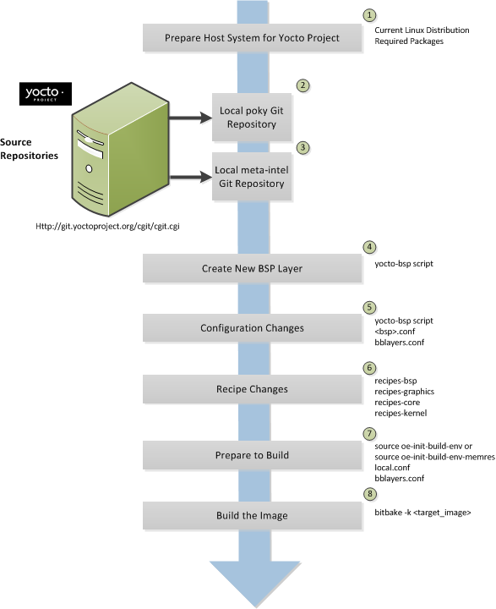
Renesas Yocto Build system
http://www.yoctoproject.org/docs/1.8/dev-manual/dev-manual.html#developing-a-board-support-package-bsp
1. Set up your host development system to support development using the Yocto Project
Host System: Ubuntu 14.04 LTS
Install necessary SW Packages
Local meta-<bsp>
Git Rpository
$ sudo apt-get install sed wget cvs subversion git-core coreutils unzip texi2html texinfo libsdl1.2-dev docbook-utils gawk python-pysqlite2 diffstat help2man make gcc build-essential g++ desktop-file-utils chrpath libgl1-mesa-dev libglu1-mesa-dev mercurial autoconf automake groff bc libtool xterm gcc-multilib chrpath socat

Slide 31
Renesas Yocto Build systeM
http://www.yoctoproject.org/docs/1.8/dev-manual/dev-manual.html#developing-a-board-support-package-bsp
2. Establish a local copy of the Yocto Project Release on your system
Reference system of the Yocto Project
metadata (base layer of recipes, classes, associated files)
$ cd $WORK
$ git clone git://git.yoctoproject.org/poky
$ cd poky
$ git checkout -b tmp yocto-1.6.1
$ git cherry-pick 17daa2ba6280304771c5fe52b94eb56f0c087490 $ git cherry-pick 8e0c54cd0e82ffe120f84f495101cd29e6fd06bf
Local meta-<bsp>
Git Rpository
$ cd $WORK
$ git clone git://git.openembedded.org/meta-openembedded
$ cd meta-openembedded
$ git checkout -b tmp dca466c074c9a35bc0133e7e0d65cca0731e2acf

Slide 32
Renesas Yocto Build system
http://www.yoctoproject.org/docs/1.8/dev-manual/dev-manual.html#developing-a-board-support-package-bsp
3. Establish Board Support Packages (BSPs) repository on your system
BSP to modify/build
Linaro toolchain to compile
$ cd $WORK
$ git clone https://github.com/renesas-rz/meta-renesas
Local meta-<bsp>
Git Rpository
$ cd $WORK
$ git clone git://git.linaro.org/openembedded/meta-linaro.git
$ cd $WORK/meta-linaro
$ git checkout -b tmp 8a0601723c06fdb75e62aa0f0cf15fc9d7d90167

Slide 33
Renesas Yocto Build system
RZ-G1_Doorphone_Quick_Start_Guide_v0.13.pdf
http://www.yoctoproject.org/docs/1.8/dev-manual/dev-manual.html#developing-a-board-support-package-bsp
4. Create our own BSP demo layer
Layers for Demonstrations
Proprietary graphics and multimedia
$ cd $WORK
$ git clone https://github.com/renesas-rz/meta-rzg-demos
$ git clone https://github.com/meta-qt5/meta-qt5.git
$ cd meta-qt5
$ git checkout –b tmp d6fe20e6083d421cc6091892e1d302c46e2d075d
Local meta-<bsp>
Git Rpository
$ mkdir $WORK/proprietary
$ cd $WORK/proprietary $ cp RZG_Series_Evaluation_Software_Package* ./
$ unzip RZG_Series_Evaluation_Software_Package_for_Linux-20150727.tar.zip $ unzip RZG_Series_Evaluation_Software_Package_of_Linux_Drivers-20150727.tar.zip
$ cd $WORK/meta-renesas/meta-rzg1 $ ./copy_gfx_software_<board>.sh ../../proprietary $ ./copy_mm_software_lcb.sh ../../proprietary

Slide 34
Renesas Yocto Build system
http://www.yoctoproject.org/docs/1.8/dev-manual/dev-manual.html#developing-a-board-support-package-bsp
5. Make configuration changes
Default configuration files: There 4 demos in meta-rzg1 (hmi_demo, qt_hmi_demo, mmpoc_demo, doorphone). Each of Demos will contain the configuration files (local.conf & bblayer.conf) which is specific for each board.
Local meta-<bsp>
Git Rpository
$ ls $WORK/meta-rzg-demos/meta_rzg1/<demos>/template/<board>/*
local.conf bblayer.conf

Slide 35
Renesas Yocto Build system
http://www.yoctoproject.org/docs/1.8/dev-manual/dev-manual.html#developing-a-board-support-package-bsp
6. Make recipe changes
Recipe changes include altering recipes (.bb files), removing recipes you do not use, and adding new recipes or append files (.bbappend) that you need to support your hardware.
All the changes for BSP recipes you can find in meta-rzg-demos/meta-rzg1/<demos>/
Local meta-<bsp>
Git Rpository

Slide 36
Renesas Yocto Build system
http://www.yoctoproject.org/docs/1.8/dev-manual/dev-manual.html#developing-a-board-support-package-bsp
7. Prepare for the build
Environment setup
Configuration file for board
Demonstrations layer is specified in $WORK/build/conf/bblayers.conf
$ cd $WORK
$ source poky/oe-init-build-env
Local meta-<bsp>
Git Rpository
$ cd $WORK
$ cp $WORK/meta-rzg-demos/meta_rzg1/hmi_demo/template/<board>/* ./conf
${TOPDIR}/../meta-rzg-demos \

Slide 37
Renesas Yocto Build system
http://www.yoctoproject.org/docs/1.8/dev-manual/dev-manual.html#developing-a-board-support-package-bsp
8. Build the image
The OpenEmbedded build system uses BitBake tool to build images based on the type of image you want to create.
The configuration files (local.conf & bblayer.conf) will specific what image will be build. There are 3 image will be build depending on how you config these files (hmi_demo, qt_demo, mmpoc_demo, doorphone)
$ bitbake core-image-weston
Local meta-<bsp>
Git Rpository

Slide 38
Renesas Yocto Build system – meta-RZG-DEMOS
Demonstrations (echo of demonstrations layer below include vary of available applications & scripts to run demonstrations)
HMI Demonstrations (hmi_demo): Playback video, Camera preview, Streaming via Lan, Streaming via WiFi, 3D graphics.
Qt HMI Demonstrations (qt_hmi_demo): Qt Cinematic, Qt everywhere, Qt launch, Qml video, Qml videofx.
MMPOC Demonstrations (mmpoc_demo): MJPEG Camera demo, HW vs SW comparison, File player, Camera preview (RCA),
Doorphone (doorphone): Doorphone application demo.
Frameworks are used mainly in the demonstrations
Qt: Multiple platform programing framework
GStreamer: Multimedia framework

Slide 39
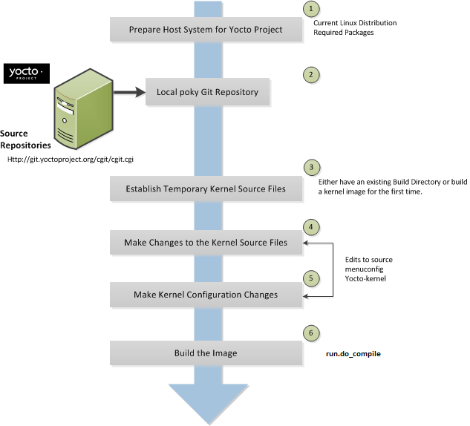
Renesas Yocto Build system – Hints/Tips
http://www.yoctoproject.org/docs/1.8/dev-manual/dev-manual.html#modifying-the-kernel
Modify the Kernel
General workflow
1->3: Reuse from BSP building
4. Make changes to the kernel source code if applicable in the Build Directory
5. Make kernel configuration changes if applicable using “menuconfig”
6. Rebuild the kernel image with your changes
Note
“bitbake -k <target_image>”: applicable when Yocto configuration changes (not re-run task to save time)
“bitbake –C compile <target_image>”: applicable when Source changes
“bitbake –fc install <target_image>”: applicable when Source changes

Slide 40
Renesas Yocto Build system – Hints/Tips
http://www.yoctoproject.org/docs/1.8/dev-manual/dev-manual.html#modifying-the-kernel
Modify the Kernel
Example on GUI (enable wireless USB and touch screen driver)
Open kernel menuconfig
Enable wireless USB adapter (with Ralink chipset) configuration
Enable general touch screen driver configuration
Save and exit the menuconfig.
Rebuild the kernel image
$ cd $WORK/build/tmp/work/iwg20m-poky-linux-gnueabi/linux-renesas/3.10+git165e12ce2d7839e755debbec78dfa43b54345275-r0/git/
$ make ARCH=arm menuconfig
$ cd $WORK/build/tmp/work/iwg20m-poky-linux-gnueabi/linux-renesas/3.10+git165e12ce2d7839e755debbec78dfa43b54345275-r0/temp
$ ./run.do_compile
$ cp $WORK/build/tmp/work/iwg20m-poky-linux-gnueabi/linux-renesas/3.10+git165e12ce2d7839e755debbec78dfa43b54345275-r0/git/arch/arm/boot/uImage $WORK/build/tmp/deploy/images/skrzg1m/uImage

Slide 41
Renesas Yocto Build system – Renesas BSP
meta-renesas
common
Recipes for common images & packages which change rarely.
meta-rzg1
Recipes for all drivers support modules on RZG SoC & packages which specified for RZG only

Slide 42
Renesas Yocto Build system – Renesas BSP
meta-renesas
meta-rzg1
recipes-bsp
Recipes for u-boot & rzg board configuration
recipes-core
Recipes for base file & utilities like libmemcpy, ncurse, udev
recipes-devtools
Recipes develop tools (gdb)
recipes-extended
Recipes for extended utilities
recipes-graphics
Recipes for gles, image, mesa, qt, wayland, configurations relate to graphics.
recipes-kernel
Recipes for all drivers support module on RZG SoC (Renesas BSP)
recipes-multimedia
Recipes for user interface library support call function of HW driver, patch files for gstreamer plugins.
Notes:
udev is a device manager for the Linux kernel. As the successor of devfsd and hotplug, udev primarily manages device nodes in the /dev directory. At the same time, udev also handles all user space events raised while hardware devices are added into the system or removed from it, including firmware loading as required by certain devices.

Slide 43
Renesas Yocto Build system – Renesas BSP
meta-renesas
meta-rzg1
recipes-kernel
linux
Recipes & config for linux kernel & device tree
gles-module
Recipes for OpenGL ES
fdpm-module
Recipes for FDPM module driver
mmngr-module
Recipes for MMNGR module driver (Mange memory)
s3ctl-module
Recipes for SC3CTL module driver
uvcs-module
Recipes for UVCS module driver (Mange VCP3)
vspm-module
Recipes for VSPM module driver (Manage VSP, 2DDMAC)
Notes:
udev is a device manager for the Linux kernel. As the successor of devfsd and hotplug, udev primarily manages device nodes in the /dev directory. At the same time, udev also handles all user space events raised while hardware devices are added into the system or removed from it, including firmware loading as required by certain devices.

Slide 44
Renesas Yocto Build system – Renesas BSP
meta-renesas
meta-rzg1
recipes-multimedia
gstreamer
libomxil
omx-module
Recipes for user interface library.
v4l2apps
dtv-module
Notes:
udev is a device manager for the Linux kernel. As the successor of devfsd and hotplug, udev primarily manages device nodes in the /dev directory. At the same time, udev also handles all user space events raised while hardware devices are added into the system or removed from it, including firmware loading as required by certain devices.

Slide 45
Renesas Yocto Build system – Renesas BSP
meta-renesas
meta-rzg1
recipes-multimedia
s3ctl-module
vspm-module
Recipes for user interface library.
fdpm-module
mmngr-module
Notes:
udev is a device manager for the Linux kernel. As the successor of devfsd and hotplug, udev primarily manages device nodes in the /dev directory. At the same time, udev also handles all user space events raised while hardware devices are added into the system or removed from it, including firmware loading as required by certain devices.

Slide 46
Agenda
Basic information & knowledge
Training Content
Hardware requirement & configuration
Linux & Development environment
RZG Overall Picture
Yocto build System & Renesas BSP
Practice: Yocto Building
GStreamer
Practice: GStreamer pipeline
Qt framework
Demonstrations & Features
Practice: Setup & Run Demonstrations

Slide 47
Overview
Yocto versions
Poky-1.6.1 with Specific commit of meta-openembedded
Preliminary steps
Install required packages for Ubuntu 14.04 LTS
Building the BSP for Renesas RZ/G1M iWave with Yocto recipe 1.10.0
Procedure: Download required files, Setup build env/board configuration, and Build
Duration: a few hours depending on your host system performance (Eg: ~2 hours on Ubuntu-x64 core i5-3570 3.4GHz, RAM 4GB-1600MHz, HDD)
Output (Eg: iWave weston/wayland)
uImage
uImage-r8a77430-iwg20m_q7.dtb
core-image-weston-iwg20m_q7.tar.bz2
Running Yocto image
Load kernel/rootfs via TFTP/NFS or microSD card or eMMC.

Slide 48
Practice
http://elinux.org/RZ-G/Boards/Yocto
RENESAS_RCH2M2E2_YoctoStartupGuide_UME_v1.30.pdf
Silk_RZ-G1_Doorphone_Compact_System_Application note.docx
Category | Step
Preliminary | Install required packages for Ubuntu
Building the BSP for iWave weston/wayland | Create a build directory and switch to it
 | Clone basic Yocto layers and Switch to proper branches
 | Clone Renesas BSP layer
 | Clone board specific configuration repository and switch to the proper branch
 | Copy proprietary software into recipe directory structure
 | Setup build environment
 | Prepare default configuration files
 | Start the build
Running Yocto image | Load kernel via TFTP and rootfs via NFS
 | Or Load kernel and rootfs from microSD card
 | Or Load kernel and rootfs from eMMC

Slide 49
Agenda
Basic information & knowledge
Training Content
Hardware requirement & configuration
Linux & Development environment
RZG Overall Picture
Yocto build System & Renesas BSP
Practice: Yocto Building
RZG MMPKG Introduction & Gstreamer Framework
Practice: GStreamer pipeline
Qt framework
Demonstrations & Features
Practice: Setup & Run Demonstrations

Slide 50
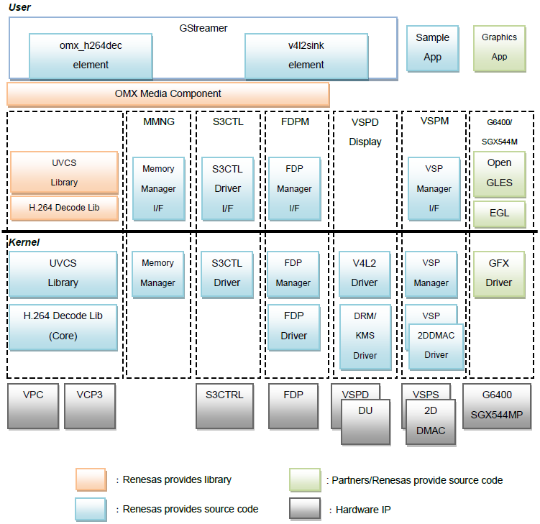
RZG MMPKG & SOFWARE STACK
RCH2M2E2_MMP_Linux_Specification_091.pdf

Slide 51
RZG MMPKG - List of Components
No9 7_Jul RZG SW solution status and plan20150707(Gojima-san).pptx
Item | Function | Layer | Module Name | License | Execution form | Code | Use HW IP
Video Decode | H.264/AVC | User | OMX-H.264/AVC Decoder MC | Proprietary | DLL(so) | Binary | VCP,VPC, S3CTRL
 |  |  | OMX-Manager | Proprietary | DLL(so) | Binary
 |  |  | UVCS Decoder | Proprietary | DLL(so) | Binary
 |  |  | VCP3 Driver Common Decoder | Proprietary | DLL(.so) | Binary
 |  |  | VCP3 Driver H.264/ AVC Decoder Library | Proprietary | DLL(.so) | Binary
 |  | Kernel | UVCS Common | GPLv2 | Module driver (,ko) | Source
 |  |  | VCP3 Driver Core | GPLv2 | Source code | Source
Video processing | IP Conversion Interlace to Progressive Conversion | User | FDP Manager IF | Proprietary | Shared library | Source | FDP, S3CTRL , TMU(3ch)
 |  | Kernel | FDP Manager | GPLv2 | Module driver (,ko) | Source
 |  |  | FDP Driver | GPLv2 | Module driver (,ko) | Source
 | Resize, Blend and Rotation | User | VSP Manager IF | Proprietary | Shared library | Source | VSP-sys 2D-DMAC
 |  | Kernel | VSP Manager | GPLv2 | Module driver (,ko) | Source
 |  |  | 2DDMAC Driver | GPLv2 | Module driver (,ko) | Source
 |  |  | VSP Driver | GPLv2 | Module driver (,ko) | Source
System Control | Memory Manager | User | Memory Manager IF | Proprietary | Shared library | Source
 |  | Kernel | Memory Manager | GPLv2 | Module driver (,ko) | Source
 | TL conversion (S3CTRL) | User | S3CTRL Driver IF | Proprietary | Shared library | Source | S3CTRL
 |  | Kernel | S3CTRL Driver | GPLv2 | Module driver (,ko) | Source

Slide 52
RZG MMPKG -List of Components
No9 7_Jul RZG SW solution status and plan20150707(Gojima-san).pptx
Item | Function | Layer | Module Name | License | Execution form | Code | Use HW IP
Video Encode | H.264 | User | OMX-H.264/AVC Encoder MC | Proprietary | DLL(.so) | Binary | VCP,VPC, S3CTRL
 |  |  | UVCS Encoder | Proprietary | DLL(so) | Binary
 |  |  | VCP3 Driver Common Encoder | Proprietary | DLL(.so) | Binary
 |  |  | VCP3 Driver H.264/AVC Encoder Library | Proprietary | DLL(.so) | Binary
Graphics | OpenGL ES2.0 | User | Open GL-ES | IMG | Shared library | Source | SGX
 |  |  | Wayland WSEGL | Proprietary | Shared library | Source
 |  | Kernel | SGX Driver | GPLv2 | Module driver (,ko) | Source

Slide 53
GStreamer in RZG Overall picture
Multimedia Apps/Tool
GStreamer Applications:
Case Video Playback
GStreamer Framework
Gst-omx plugins
(omxh264dec)
Gst plugins base
(vspmfilter)
Gst plugins bad
(waylandsin)
SW
User Space
Wayland/Weston
OMX Video
VSP Mgr I/F
DRM/KMS
Kernel Space
VCP Drv.
VSP Mgr.
DU/VSPD Drv.
HW
HW IP
VCP3
VSP
VSPD
DU
Notes:
What GStreamer can do: Receiver video from capturer, decode video, encode video, convert video properties, output the suitable video data for displaying.

Slide 54
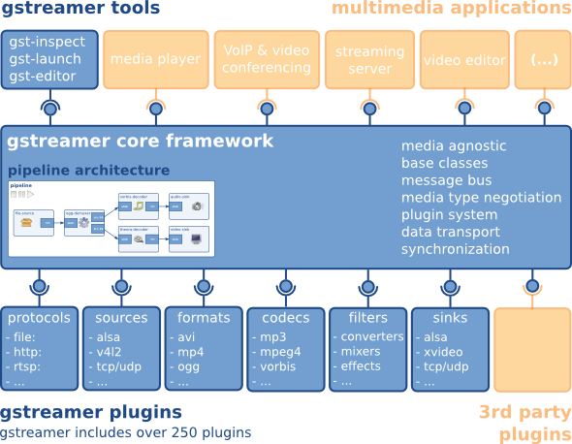
GStreamer – What is it?
http://GStreamer.freedesktop.org/data/doc/GStreamer/head/manual/manual.pdf
GStreamer is a framework for creating streaming media applications:
Varies of tools & applications for multimedia content performance
GStreamer core with many useful functionality for debuging & programing to process multimedia content
GStreamer plugins: the sets of varies of library for multimedia support (get file data, decode media content, display on scree, …)
Each of library provide varies of ELEMENTS for media content processing.
Each of ELEMENT responsibles for the specific task
Notes:
Fix:

Slide 55
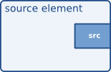
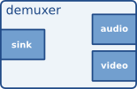
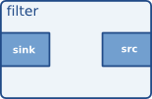
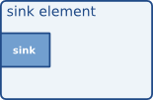
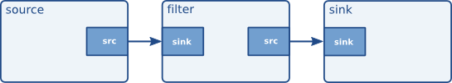
GStreamer – concepts
http://GStreamer.freedesktop.org/data/doc/GStreamer/head/manual/manual.pdf
An element, with one specific function, is the most important class of objects in GStreamer.
By linking a the elements into a pipeline by the chain, let data flow through the chains to set up a media pipeline that can do a specific task. This is the basic concept of media handling in GStreamer.
Decoder
Pipeline for convert media content
Pipeline for playback media content

Slide 56
GStreamer – Elements
http://GStreamer.freedesktop.org/data/doc/GStreamer/head/manual/manual.pdf
Multimedia Apps/Tool
Each of element responsible for a specific functionality & may need to use the supported feature from hardware.
Source elements: do not accept data from the other elements, they only generate data for the other elements.
GStreamer Framework
Gst plugins good
(v4l2src)
V4L2 I/F
Output data to another elements
V4L2 Drv.
Camera
Get input data from lower components
VIN
TVP5150

Slide 57
GStreamer – Elements
http://GStreamer.freedesktop.org/data/doc/GStreamer/head/manual/manual.pdf
Multimedia Apps/Tool
Filters, convertors, demuxers, muxers and codecs: have both input and outputs pads
GStreamer Framework
Gst plugins base
(vspmfilter)
VSP Mgr I/F
VSP Mgr.
VSP

Slide 58
GStreamer – Elements
http://GStreamer.freedesktop.org/data/doc/GStreamer/head/manual/manual.pdf
Multimedia Apps/Tool
Sink elements: accept data but do not produce anything.
GStreamer Framework
Gst plugins bad
(waylandsin)
Wayland/Weston
DRM/KMS
output data to lower components
DU/VSPD Drv.
VSPD
DU

Slide 59
GStreamer – Pads
http://GStreamer.freedesktop.org/data/doc/GStreamer/head/manual/manual.pdf
The pads are the element's interface. Data streams from one element's source pad to another element's sink pad.
Direction
Source pads: receive data
Sink pads: generate data
Availability
Always: always exist
Sometimes: exist only in certain cases (and can disappear randomly)
On request: appear only if explicitly requested by applications
Capabilities: describe the data that can flow through the pad
either be a list of possible caps, in which case the pad is not yet negotiated
or it is the type of media that currently streams over this pad, in which case the pad has been negotiated already.
Pad Templates:
SRC template: 'src'
Availability: Always
Capabilities:
audio/x-raw
format: F32LE
rate: [ 1, 2147483647 ]
channels: [ 1, 256 ]
SINK template: 'sink'
Availability: Always
Capabilities:
audio/x-vorbis

Slide 60
GStreamer – TOOls
http://GStreamer.freedesktop.org/data/doc/GStreamer/head/manual/manual.pdf
Factory Details:
Long name: QuickTime demuxer
Class: Codec/Demuxer
Description: Demultiplex a QuickTime file into audio and video streams
Author(s): David Schleef <ds@schleef.org>, Wim Taymans <wim@fluendo.com>
Rank: primary (256)
gst-inspect: tool provide some generic information about an element
gst-launch: tool use as the command line on linux console/terminal, allow to link a source element with zero or more filter-like elements and finally a sink element, let data flow through the chains to set up a media pipeline that can do a specific task.
$ gst-inspect qtdemux
Factory Details:
Long name: QuickTime demuxer
Class: Codec/Demuxer
Description: Demultiplex a QuickTime file into audio and video streams
Author(s): David Schleef <ds@schleef.org>, Wim Taymans <wim@fluendo.com>
Rank: primary (256)
Decoder
(filesrc)
(Qtdemux)
(Omxh264dec)
(waylandsink)
$ gst-launch-1.0 filesrc location=/file_a.mp4 ! qtdemux name=q q.video_0 ! omxh264dec ! waylandsink

Slide 61
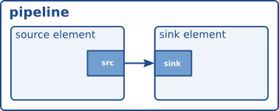
GStreamer – Hello world
https://GStreamer.freedesktop.org/data/doc/GStreamer/head/manual/html/chapter-helloworld.html#section-helloworld
Goal: we will learn
How element use in source code
How to connect elements to each other.
How to customize element's behavior.
How to watch the bus for error conditions and extract information from messages.
Walkthrough
Initialize GStreamer
Create pipeline
Create elements
gst_init (&argc, &argv);
pipeline = gst_pipeline_new (“audio-player");
source = gst_element_factory_make ("filesrc", "file-source");
demuxer = gst_element_factory_make ("oggdemux", "ogg-demuxer");
decoder = gst_element_factory_make ("vorbisdec", "vorbis-decoder");
conv = gst_element_factory_make ("audioconvert", "converter");
sink = gst_element_factory_make ("autoaudiosink", "audio-output");

Slide 62
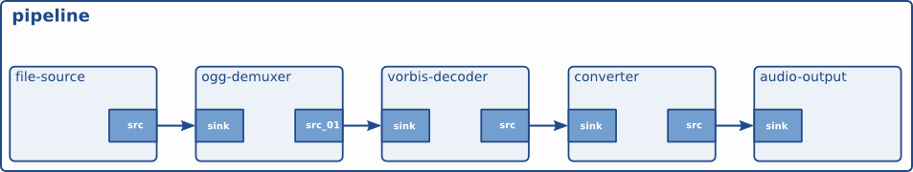
GStreamer – Hello world
http://docs.GStreamer.com/display/GstSDK/Basic+tutorial+2%3A+GStreamer+concepts
Walkthrough
Add the created elements to bin of pipeline
Link the elements in pipeline
Start to play
gst_bin_add_many (GST_BIN (pipeline), source, demuxer, decoder, conv, sink, NULL);
gst_element_link (source, demuxer);
gst_element_link_many (decoder, conv, sink, NULL);
gst_element_set_state (pipeline, GST_STATE_PLAYING);

Slide 63
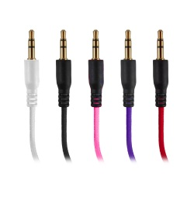

GStreamer – Hello world
http://docs.GStreamer.com/display/GstSDK/Basic+tutorial+2%3A+GStreamer+concepts
Linux PC
Walkthrough
Compile source code
Run
$ gcc -Wall helloworld.c -o helloworld $(pkg-config --cflags --libs GStreamer-1.0)
Audio cable
$ ./helloworld file_audio.ogg

Slide 64
Gstreamer – textoverlay
Extend
Overlay text/time on frame (also display on screen):
Example pipeline:
Current RZG Performance
Static text append & display: Same performance with video playback in the case HD Video
Input Video file FHD 60fps: CPU ~48%, fps: ~27.
Time append & display:
Input Video file FHD 60fps: CPU ~47%, fps: ~25.
Pipeline
filesrc
Demux
omxdec
filter
text/timeoverlay
waylandsink
src
sink
src
sink
src
sink
src
sink
src
sink

Slide 65
Gstreamer – textoverlay
Extend
Sub file:
1
00:00:03,000 --> 00:00:05,000 Hello? (3-5s)
2
00:00:08,000 --> 00:00:13,000 Yes, this is a subtitle. Do you like it? (8-13s)
3
00:00:18,826 --> 00:01:02,886 Uh? What are you talking about? I don't understand (18-62s)
…
Overlay subtitle changed by file specific
Example pipeline:
Current RZG Performance
Input Video file FHD 60fps: CPU: ~56%, fps: ~32
Pipeline
Video
filesrc
Demux
omxdec
filter
textoverlay
waylandsink
src
sink
src
sink
src
sink
src
sink
src
sink
filesrc
subparse
Text
src
sink
src

Slide 66
Gstreamer – textRENDER
Extend
Overlay Time on on frame/screen: Time change at second
Example pipeline:
Current RZG Performance (iWave RZG1M)
Render text on screen with framerate 30fps (use while loop): CPU ~50%
Render text on screen with framerate 15fps (use while loop): CPU ~25%
Pipeline
fdsrc
textrender
videoconvert
waylandsink
src
sink
src
sink
src
sink
src

Slide 67
Agenda
Basic information & knowledge
Training Content
Hardware requirement & configuration
Linux & Development environment
RZG Overall Picture
Yocto build System & Renesas BSP
Practice: Yocto Building
GStreamer
Practice: GStreamer pipeline
Qt framework
Demonstrations & Features
Practice: Setup & Run Demonstrations

Slide 68
GST Practice – gst-launch
http://GStreamer.freedesktop.org/data/doc/GStreamer/head/manual/manual.pdf
http://docs.GStreamer.com/display/GstSDK/gst-launch
http://docs.GStreamer.com/display/GstSDK/Basic+tutorial+10%3A+GStreamer+tools
Function: construct pipelines based on a command-line syntax.
Synopsis
Description
Elements: a PIPELINE-DESCRIPTION is a list of element types separated by exclamation marks (!)
Properties: may be appended to elements, in the form property=value (multiple properties can be specified, separated by spaces)
Named elements: Elements can be named using the name property, to create complex pipelines involving branches. Named elements are referred to using their name followed by a dot.
gst-launch [OPTION...] PIPELINE-DESCRIPTION
$ gst-launch-1.0 audiotestsrc ! alsasink
$ gst-launch-1.0 filesrc location=file.mp4 ! qtdemux ! omxh264dec ! waylandsink
$ gst-launch-1.0 filesrc location=file.mp4 ! qtdemux name=demuxer ! queue ! omxh264dec ! waylandsink demuxer. ! queue ! faad ! alsasink

Slide 69
GST Practice – gst-launch
https://socrm.dgn.renesas.com/issues/73079#change-556563
http://docs.GStreamer.com/display/GstSDK/gst-launch
http://docs.GStreamer.com/display/GstSDK/Basic+tutorial+10%3A+GStreamer+tools
Description
Pads: specify the Pads directly instead of letting GStreamer choose which Pad to use when linking two elements, by adding a dot plus the Pad name after the name of the element (it must be a named element).
Caps filters: remove ambiguity when linking an element with an element that has more than one output pad.
Options
-v, --verbose: Output status information and property notifications
-rp: monitor framerate of each element (with patch)
$ gst-launch-1.0 filesrc location=file.mp4 ! qtdemux name=demuxer demuxer.video_0 ! omxh264dec ! waylandsink
$ gst-launch-1.0 filesrc location=file.mp4 ! qtdemux ! omxh264dec ! video/x-raw ! waylandsink

Slide 70
GST Practice – gst-inspect
http://GStreamer.freedesktop.org/data/doc/GStreamer/head/manual/html/section-programs-gst-inspect.html http://docs.GStreamer.com/display/GstSDK/Basic+tutorial+10%3A+GStreamer+tools
http://docs.GStreamer.com/display/GstSDK/gst-inspect
Function: query a plugin or an element about its properties.
Synopsis
Options
Without arguments, it lists all available elements types, this is, the types you can use to instantiate new elements.
PLUGIN: With a file name as an argument, it treats the file as a GStreamer plugin, tries to open it, and lists all the elements described inside.
ELEMENT: With a GStreamer element name as an argument, it lists all information regarding that element.
-a, --print-all: Print all plugins and elements
gst-inspect [OPTION...] [PLUGIN|ELEMENT]
$ gst-inspect
$ gst-inspect /usr/lib/GStreamer-1.0/libgstaudiotestsrc.so
$ gst-inspect audiotestsrc
$ gst-inspect -a

Slide 71
Agenda
Basic information & knowledge
Training Content
Hardware requirement & configuration
Linux & Development environment
RZG Overall Picture
Yocto build System & Renesas BSP
Practice: Yocto Building
GStreamer
Practice: GStreamer pipeline
Qt framework
Demonstrations & Features
Practice: Setup & Run Demonstrations

Slide 72
QT in RZG Overall picture
Qt Apps/Tool
Qt on RZG platform:
RZG has supported Qt5.6
Qt Framework
GStreamer Framework
SW
User Space
Gst plugins
(Gst-omx plugin, gst plugin base/bad/good, ..)
V4l2,VSP,… I/F
OMX Lib I/F
Wayland/Weston
…
Opengl ES
Kernel Space
V4L2 Drv.
VSP Mgr.
DU/VSPD Drv.
…
SGX Drv.
HW
HW IP
VIN
VSP
VSPD
…
SGX
DU

Slide 73
Qt – What is it?
Concept:
Qt is a cross-platform application development framework for desktop, embedded and mobile.
Mainly & Quickly for developing application software with graphical user interfaces (GUIs)
Supported Platforms include Linux, OS X, Windows, VxWorks, QNX, Android, iOS, BlackBerry, Sailfish OS and others.
Advantage:
Coding in one machine but use for many supported machine/platform
Qt Creator included: a very capable IDE which works on many supported platform, provide a completely development environment. Support quickly & attractively GUI design for application.
Support many available tools, multimedia & graphics (include 3D) demos & functionality for quickly demon the ability of system.
License:
Community version: free software under several versions of the GPL and the LGPL (Licensing FAQ).
Commercial versions which contain additional functionality and libraries: sold by the Qt Company

Slide 74
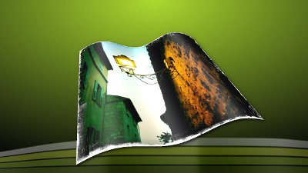
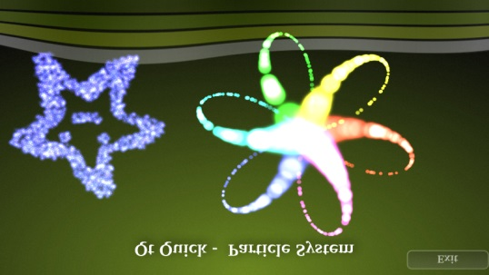
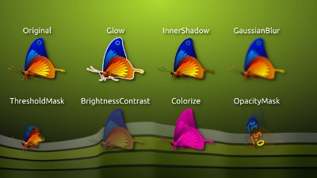
Qt – Qt5 Key features
http://doc.qt.io/qt-5/qt5-intro.html
Amazing Graphics Capability and Performance
OpenGL-based scene graph to accelerate the graphics of Qt Quick, providing velvet aminations. Particles and impressive graphical effects.
Multimedia – Audio, Video, Camera support on all major platform
Webengine, full HTML5 support from the world’s most popular web engine.
ShaderEffect on an Image
Qt Quick's Particle System
Excerpts from the Qt Graphical Effects module
Notes:
Qt quick: the type name of project build with Qt creator and run on Qt framework. Qt quick provide the GUI programming on QML language and control programming with C++ language.

Slide 75
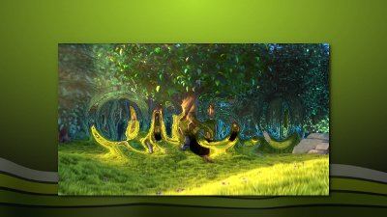
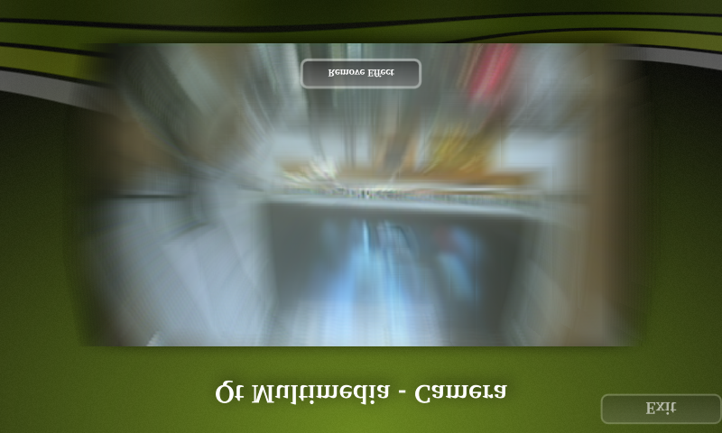
Qt – Qt5 Key features
http://doc.qt.io/qt-5/qt5-intro.html
Multimedia
Handle multimedia content, access the camera and radio functionality.
Video embedded into a Qt Quick application with a displacement effect
Camera demo with zoom effect

Slide 76
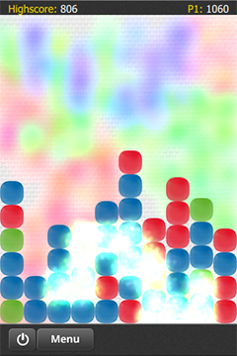

RZ/G Qt – QML application
3D graphics examples in Qt framework
samegame | maroon

Slide 77
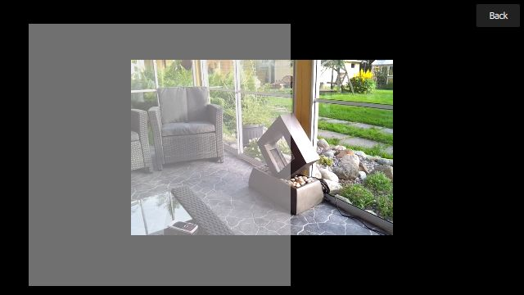
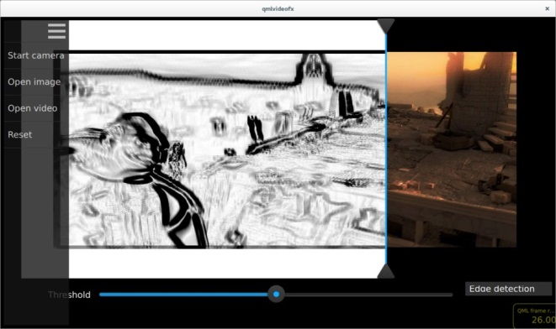
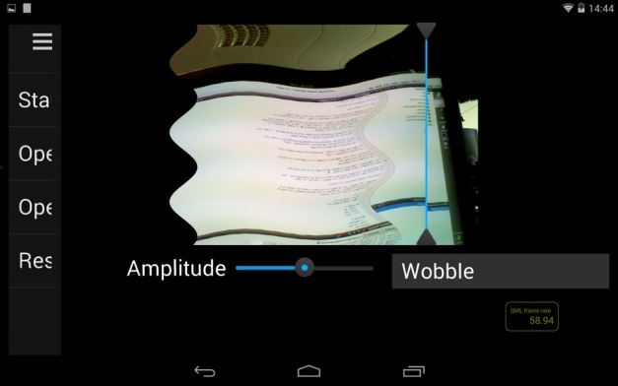
RZ/G Qt – QML application
http://doc.qt.io/qt-5/qtmultimedia-video-qmlvideo-example.html
http://doc.qt.io/qt-5/qtmultimedia-video-qmlvideofx-example.html
Multimedia examples in Qt framework
QML Video Example
QML Video Shader Effects Example
page curl effect applied to video | 'wobble' effect applied to camera

Slide 78
Qt – QML Applications
http://doc.qt.io/qt-5/qmlapplications.html
Overview
QML: a user interface specification and programming language
Qt Quick: the standard library of types and functionality for QML, including visual types, interactive types, animations, models and views, particle effects and shader effects.
QML User Interfaces
Basic UI controls: Buttons, Menus, and other Controls
Special Effects
Particle Effects: to simulate certain kinds of "fuzzy" phenomena
Graphical Effects: to creating image composition effects.
Viewing Web Content in QML Applications
Sensorsa, Gestures, and Touch Interfaces
Multimedia Content
Audio: audio input, output and processing
Video: playing and manipulating video data
Camera: access images and videos from cameras
Radio: control over the radio tuner of the system and access RDS information
Qt Audio Engine: 3D positional audio playback and content management.

Slide 79
RZ/G Qt – Overview
RZ-G1_QT-Demonstration_note.pptx
Qt5.6
Integrated Qt5.6 into Yocto recipe 1.10.0 build system
Handle multimedia content with GStreamer as Multimedia backend
waylandsink: to achieve the maximum video display performance
VideoPlayback: handle H.264 video playback from SD card
AudioStreaming: handle AAC audio streaming and receiving among 2 devices
VideoStreaming: handle H.264 video receiving from multi inputs and streaming other external devices via RTSP server
VideoRecording: handle H.264 video recording to SD card
qtvideorenderersink: to achieve video display with Graphical effects
MediaPlayer: allow the playing of a media source
Camerabin: allow the preview of a camera source
AudioDecoder: allow decoding audio
MediaCapture: allow the recording of media content (not supported component)

Slide 80
RZ/G Qt – Overview
RZ-G1_QT-Demonstration_note.pptx
GUI: OpenGL and OpenGL|ES 2.0 Integration
Performance measurement
CpuMonitor: evaluate CPU load in system
MemMonitor: evaluate memory usage in system
Axistat: evaluate bus load in system (read/write bus load of GPU/CPU/whole system)
QML Applications:
Some defaults applications in Qt5.6 framework
Qt everywhere/Cinematic experience/Launch with qtvideorenderersink display to achieve video playback and camera preview with Graphical effects. (Qt Cinematic display fullHD 60fps, Qt qmlvideo/qmlvideofx display video HD 30fps)
DoorPhone
With waylandsink display to achieve the maximum video playback performance (1 display @960x480 and 3 displays @320x240 – 30fps)
With some other modifications in the system to support touch screen, streaming, etc.

Slide 81
RZ/G Qt – IN Yocto build system
Function: Qt5.6 into Yocto 1.10.0 build system for iWave
Yocto recipe 1.10.0 for iWave
Structure
WORK_DIR
build
meta-linaro
meta-openembedded
meta-renesas
meta-rzg-demos
meta-rzg1
qt_hmi_demo
recipes-qt
Qt layer for RZG
poky
meta-qt5
Qt5 layer for openembedded

Slide 82
Agenda
Basic information & knowledge
Training Content
Hardware requirement & configuration
Linux & Development environment
RZG Overall Picture
Yocto build System & Renesas BSP
Practice: Yocto Building
GStreamer
Practice: GStreamer pipeline
Qt framework
Demonstrations & Features
Practice: Setup & Run Demonstrations

Slide 83
RZG Demonstrations
RZG Demonstrations
HMI Demo
Qt HMI Demo
Doorphone
Apps
HMI Demo
Qt HMI Demo
Doorphone
OpenGL-ES 2
Cairo
GStreamer
Qt Framework
OpenGL-ES 2
Wayland Server
Weston Compositor
Linux Kernel

Slide 84
HMI Demonstration – S/W architecture
RZ-G1_GST-SGX-Demo_Application_note.docx
GStreamer multimedia with simple GUI support, the demonstrations in HMI (with dependencies framework):
Video Playback, Camera preview, Streaming Demo (GStreamer)
RTSP Streaming path show (Cairo)
3D Graphics Demo (OpenGL-ES 2)
HMI Demo
3D Graphic
Text Drawing
Multimedia
OpenGL-ES 2
Cairo
GStreamer
Wayland Server
Weston Compositor
Linux Kernel

Slide 85
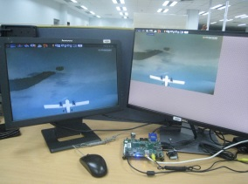
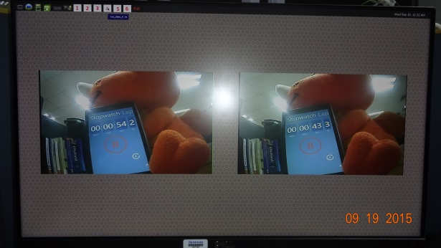
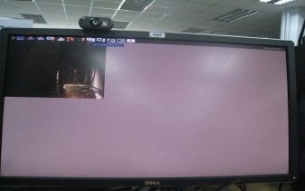
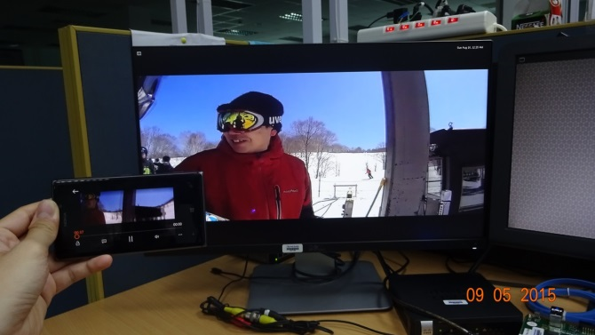
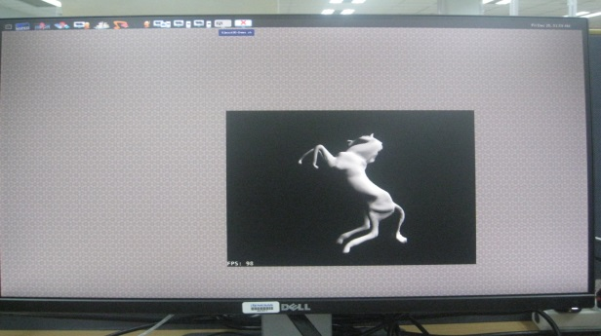
HMI Demonstration – Features
RZ-G1_GST-SGX-Demo_Application_note.docx
Video Playback | Camera preview, recording, and playback recorded data | Streaming board to board (LAN)
Streaming board to device (WiFi) | 3D Graphics

Slide 86
HMI Demonstration – Physical chart
RZ-G1_GST-SGX-Demo_Application_note.docx
Equipment List
iWave Board | 1
FHD Panel with HDMI cable | 1
HD Panel with VGA cable | 1
Composite cable | 1
Wireless Access Point | 1
USB Wireless LAN Adapter | 1
SD card | 1
Camera | 1
Smart phones or tablets | 3
RCA Camera
HDMI Cable
VGA - HD Monitor
RCA Cable
Target board
(iWave)
VGA Cable
Wireless USB
HDMI - FullHD Monitor
Wireless Router

Slide 87


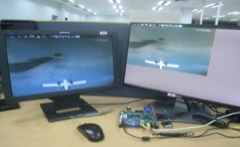

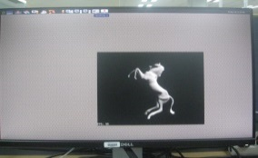
HMI Demo – Running
RZ-G1_QT-Demonstration_note.pptx
RZ-G1_GST-SGX-Demo_Application_note_v0.2
Supported demos
HMI Demos
Camera
Streaming board to board (LAN)
Show board’s IP
Stop running demo
Video Playback
Streaming board to device (WiFi)
3D Graphics

Slide 88
QT hmi Demonstrations
Qt HMI Demonstration with the Attractive graphical UI based on Qt Framework, Gstreamer, OpenGL-ES 2. The demos in packages:
Qt Cinematic
Qt Everwhere
Qt launch
Qml video
Qml Videofx
Apps
Qt HMI Demo
GStreamer
Qt Framework
OpenGL-ES 2
Wayland Server
Weston Compositor
Linux Kernel

Slide 89
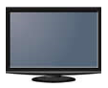
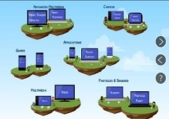
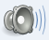
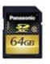
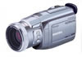

Qt HMI Demonstration – Physical chart
RZ-G1_QT-Demonstration_note.pptx
iWave board
Equipment List
iWave Board | 1
Touch screen HD Panel | 1
HDMI cable | 1
LAN cable | 1
Composite cable | 1
USB cable | 1
Wireless Access Point | 1
Internet Modem | 1
USB Wireless LAN Adapter | 1
SD card | 1
Camera | 1
Speaker | 1
Internet
Speaker
Touch screen
HD Panel
Internet
Modem
Mini-plug cable
usb cable
HDMI cable
Line out
Line in
USB Wireless LAN Adapter
Audio
USB
iWave
E2
Host I/F
Wireless
Micro SD
VIN
LAN
Internet cable
SD Card
Composite cable
Wireless
Wireless Access Point
camera

Slide 90
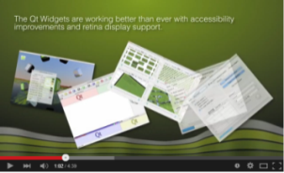
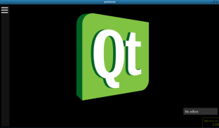
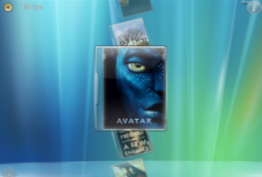


Qt Sample – Running
RZ-G1_QT-Demonstration_note.pptx
RZ-G1_GST-SGX-Demo_Application_note_v0.2
Operation flow of Main menu control
Touch/Click on each icon to start the corresponding demonstration
Touch/Click ‘X’ to close the running demonstration. This step is mandatory since the system is currently unstable with multi-demonstration.
Touch/Click 'Exit' to stop the whole demonstration
Launch
qmlvideofx
More information
Cinematic
Everywhere
qmlvideo

Slide 91
Qt Sample – Running
RZ-G1_QT-Demonstration_note.pptx
RZ-G1_GST-SGX-Demo_Application_note_v0.2
Limitation
Touch and sound function of LVDS won't work if we reboot board.
Reason: problem relate to origin unstable BSP for iWave.
Work arround: Do not reboot board, If you want to restart board, please turn off and plug out power, plug in power & start board again.
Weston dumped randomly when cloes right after open the applications (Qt Cinematic, Qt launch, Qt everwhere) in the short time.
Reason: problem relate to origin unstable BSP for iWave.
Workarround: Restart board if don’t have terminal for control, or restart weston if can control board through terminal.
Performance display incorrectly: Qt Cinematic Demo display 54 fps, Qmlvideo/Qmlvideofx display 26fps on HDMI screen
Reason: Qt demos getting refresh rate from LVDS refresh rate (Max refresh rate = 54fps) to calculate fps when 2 LCD display at the same time.
Work arround: Turn off LVDS screen if we want to display correct fps on HDMI screen. Please add follow lines in file /etc/xdg/weston/weston.ini
[output]
name=LVDS1
mode=off

Slide 92
Qt Sample Demonstration – Features
RZ-G1_QT-Demonstration_note.pptx
Qt Cinematic Experience
No | Function | Description
1 | showFogParticles | Create fog flying from the bottom to the middle.
2 | showShootingStarParticles | Create a shooting star and particles running following a specific path.
3 | showLighting | Create lighting running around the movie cover.
4 | showColors | Change the background from black to color, color of fog and particles.

Slide 93







Qt Sample Demonstration – Features
RZ-G1_QT-Demonstration_note.pptx
Qt Cinematic Experience
A cinematic experience is shown on this Qt application with beautiful 3D graphical effects.

Slide 94
Qt Sample Demonstration – Features
RZ-G1_QT-Demonstration_note.pptx
Qt Everywhere
No | Function | Detail | Description
1 | Feeds | RSS reader (Laptop image) | Display RSS news image from XML data
2 |  | RSS reader (Tablet image) | Display RSS news image and content from XML data.
3 | Games | Same game | Demonstrate games written in Javascript
4 |  | Maroon | Demonstrate games written in Javascript
5 | Canvas | Canvas clock | Change color and number formats of clock
6 |  | Heart monitor | Display heart beat using qt canvas
7 | Application | Widget Gallery | Show Qt supported widget styles and themes.
8 |  | Photo surface | Access images in an specific directory and drag to move them
9 |  | Calqlatr | Use Qt Quick custom components and animation to move components
10 | Multimedia | Internet radio | Stream audio from internet and play
11 |  | Video | Stream video from internet and play
12 | Particales & shaders | Shaders | Demo shaders effects
13 |  | Partical paint | Demo particales effect

Slide 95












Qt Sample Demonstration – Features
RZ-G1_QT-Demonstration_note.pptx
Qt Everywhere
This application highlights Qt technology in bringing different user interface styles in several device types with one source code.

Slide 96
Qt Sample Demonstration – Features
RZ-G1_QT-Demonstration_note.pptx
Qt Launch
No | Function | Description
1 | Widgets | UI elements to create classic desktop-style user interfaces
2 | Quick | Standard library for writing QML applications
3 |  | - Fonts
4 |  | Canvas
5 |  | - Particle System
6 |  | - ShaderEffect
7 | Graphical Effects | A set of QML types for adding visually impressive and configurable effects to user interfaces
8 | Multimedia | - Video: Playback with HW Codec
9 |  | - Video: Playback with Graphical Effects
10 |  | - Camera: Camera preview
11 |  | - Camera: Preview with Graphical Effects
12 | WebKit | WebView API allows QML applications to render regions of dynamic web content

Slide 97

Qt Sample Demonstration – Features
RZ-G1_QT-Demonstration_note.pptx
Qt Launch
Start
This Demo introduces Qt 5, with descriptions and demonstrations of some Qt 5 features.

Slide 98
Qt Sample Demonstration – Features
RZ-G1_QT-Demonstration_note.pptx
QmlVideo
No | Function | Description
1 | Multiple | Play two videos in to window
2 | Video | Start/Stop playing video
3 | Drag | Can drag video window
4 | Fillmode | Change aspect site of video
5 | Fullscreen | Toggle full screen/small screen
6 | Fullscreen-inverted | Toggle full screen/small screen
7 | Meta-data | Show meta-data info of video
8 | Move | Video auto move left right while playing
9 | Overlay | Show overlay while playing video
10 | Playback Rate | Increase and reduce playback rate
11 | Resize | Auto resize video large and small
12 | Rotate | Rote video +- 30 degree
13 | Spin | Spin video around
14 | Seek | Enable seeking video
(Black : video mode support; Blue: both video and camera mode support)

Slide 99


Qt Sample Demonstration – Features
RZ-G1_QT-Demonstration_note.pptx
QmlVideo
Show Video playback and camera preview function with various transformation effects.

Slide 100



















Qt Sample Demonstration – Features
RZ-G1_QT-Demonstration_note.pptx
QmlVideoFx (All effects are supported for camera, image, and video)
Billboard
Black&white
Blur
Edge detection
Emboss
Glow
Isolate
Magnify
Page curl
Pixelate
Posterize
Ripple
Sepia
Sharpen
Shockwave
Tilt shift
Toon
Warhol
Wobble
Vignette

Slide 101

Qt Sample Demonstration – Features
RZ-G1_QT-Demonstration_note.pptx
QmlVideo

Slide 102
Doorphone
Doorphone functions
Use GStreamer for multimedia functionality
Qt Framework for GUI
OpenGL-ES 2 for some GUI component
Apps
Doorphone
GStreamer
Qt Framework
OpenGL-ES 2
Wayland Server
Weston Compositor
Linux Kernel

Slide 103
















Doorphone -GUI
RZ-G1_Doorphone_Quick_Start_Guide_v0.13.pdf
Touch “Sub Output”,
change a picture both
“Main Output” and
“Sub Output”.
DoorPhone – GUI control
Main Output (960x540)
Sub Output (320x240)
3D graphics menu
Status
Controls
Metallic silver frame
sound
Tuesday, June 09, 2015 11:05:00 AM
Graphical title plate
CPU, Memory, & Bus usage

Slide 104
Doorphone - features
RZ-G1_Doorphone_Quick_Start_Guide_v0.13.pdf
Feature | Functional
Video stream | Using LAN network, 1 composite video stream and 3 videos (file) streams will be sent From Sub-board (Outdoor cordless handset) to central board (Base phone)
 | Video in H.264 format (I-frames only)
 | Central board displays all 4 streams. The main stream will be displayed in HD or qHD resolution, while other sub streams are in QVGA resolution
Audio | Audio can be transferred between central board (Base phone) and sub-board (Outdoor cordless handset) via LAN network for talking
 | Audio is transferred in AAC format
Control via serial terminal | Launch Doorphone application in central board (Base phone) by calling its binary file in serial terminal
 | Stop Doorphone application by use Ctrl-c in terminal
Control by USB mouse of central board | User can swap between main display and sub display
 | Can communicate between Base phone and Outdoor via cordless handset device
 | Can record corresponding camera stream to SD card and playback later

Slide 105
Doorphone - features
RZ-G1_Doorphone_Quick_Start_Guide_v0.13.pdf
Feature | Functional
External device | External device (Smartphone or PC) can connect to central board via wire/wireless network by RTSPServer module for receive video stream
 | Video stream display on external device is the same as main display in central board but get some delay depends on network and external device
Compact system | Original Doorphone system uses 5 boards (1 Main 4 Sub)
 | This compact system only uses 2 boards (1 Main 1 Sub) with 3 input video replace 3 camera streams
Guest notification | Outdoor can automatically detects face of user stand in front of the camera by face detection feature of OpenCV
 | Outdoor will take a picture of the Guest (user) and send to Basephone with a button press on Outdoor board. This picture will be send to a specific email by Basephone

Slide 106
Doorphone - restiction
On Android 4.1.2, VLC v1.4.1 can’t play streamed video.
For stable working on iWave board, please turn on Outdoor board after Basephone board show the welcome screen or plug the LAN cable between two boards after Basephone board show completed GUI
With RTSP, only the limitation 3-4 device connected to Base Phone
Notes:
This slide just list some particular restriction on Doorphone, for more detail please read in Doorphone Quick Start guide.

Slide 107









DoorPhone Demonstration – Physical chart
RZG_demonstration_material_20150528.pptx
DoorPhone
iWave board (receive)
iWave board (send)
FFC/HDMI Panel
Speaker
Mic
Mini-plug cable
Mini-plug cable
Speaker
Line out
Line in
Audio
USB
Mic
FFC/HDMI cable
iWave
rzg1
HDMI OUT
Mini-plug cable
Mini-plug cable
Line out
Line in
USB Wireless LAN Adapter
Micro SD
VIN
LAN
Audio
USB
Composite cable
SD Card
iWave
rzg1
Host I/F
some videos
camera
Micro SD
VIN
LAN
LAN cable
SmartPhone
SD Card
Wireless LAN
Wireless LAN Router
external device
LAN cable

Slide 108
Agenda
Basic information & knowledge
Training Content
Hardware requirement & configuration
Linux & Development environment
RZG Overall Picture
Yocto build System
Practice: Yocto Building
GStreamer
Practice: GStreamer pipeline
Qt framework
Demonstrations & Features
Practice: Setup & Run Demonstrations

Slide 109
Overview
RZ-G1_Doorphone_Quick_Start_Guide_v0.13.pdf
Deploy Yocto image
Load kernel/rootfs via TFTP/NFS or microSD card or eMMC.
HMI
Qt Demos
Doorphone
Run HMI Demonstrations
Run Qt Demonstrations
Run Doorphone Demonstrations

Slide 110
Deployment – IMG binary file
IMG_deploy_guideline
Advantage
Deploy without Linux PC necessity
Finish deployment within 1 minute
Requirement
H/W: Windows PC with Administrator permission and SD Card reader
S/W: Teraterm and Win32 Disk Imager
Procedure
Run Win32 Disk Imager as Administrator
Open delivered *.img (specific name of the binary release package)
Choose removable device name (SD card)
Write *.img to removable device. This step would take a few seconds.
Insert img written card to turned-off board. Please do not turn board on until step 8.
Open teraterm
Run delivered macro *.ttl to set up board
Turn board on. Please press “Enter” immediately to stop autoboot process. Macro running in step 7 is waiting to automatically set up u-boot to boot from the inserted removable device.

Slide 111
www.renesas.com
THANKS FOR YOUR TIME

Slide 112
Agenda
Advance & Deeper Technical knowledge
Embedded Linux & Development environment
RZG BSP Features & Development
Detail Yocto build System
RZ/G Graphics and Multimedia Package
GStreamer & MMPOC Development
Qt Framework and Overall Picture

Slide 113
Development environment
http://free-electrons.com/doc/training/embedded-linux/embedded-linux-slides.pdf
OS for Linux development: Ubuntu - widely used and easy to use
Root and non-root users
S/W packages (.deb) and Managing them (sudo apt-get or apt-cache)
Host vs. Target
Serial line communication program: Minicom (Linux) or Teraterm (Windows)
Command line for text editor (Linux): vi or vim
Notes:
OS for Linux Dev: In the current RVC use Ubuntu LTSI 14.04 x64
You need root privilege to install necessary software for building & compiling process, during run building/compiling tool/sw, you just need the non-root privilege user.
Communication between Host & Target:
+ Serial: interact (writing command, reading messages, …) with terminal through target board console interface
+ Network: May use the ssh protocol to interact or communicate with target board
- Minicom & Teraterm is 2 genera software for serial line communication purpose.

Slide 114

Cross-compiling toolchains
http://free-electrons.com/doc/training/embedded-linux/embedded-linux-slides.pdf

Slide 115
Bootloaders – Boot sequence
Initialize Linux OS in 4 stages:
Powered on
Sys startup
(QSPI Flash)
SPI Loader: Initialize CPU/board, Search for boot device, Load stage 2 boot loader from boot device.
Boot loader
(QSPI Flash -> RAM)
U-Boot: Stage 1: Find and load stage 2 boot loader into RAM
Stage 2: Load default kernel image (compressed), Load initial
RAM disk (initrd) image, and Invokes kernel image
Kernel
(NFS/SD/eMMC -> RAM)
Linux startup: Loading stage: Set up minimal env and Decompress kernel image
Boot stage: establish memory management, detect CPU type,
execute initialization functions, start the Init process,
start the idle task, and give control to the scheduler
Init
(NFS/SD/eMMC -> RAM)
Rootfs: Init is the first user-space application responsible for starting necessary system processes to configure the environment for users, including Set CPU alignment, Check and mount the rootfs for full read-write access, Load necessary drivers/modules/user services, Mount all file systems, and Set up NW
Initialized

Slide 116
Bootloaders – U-boot
http://www.denx.de/wiki/publish/U-Bootdoc/U-Bootdoc.pdf
Introduction: U-Boot (Universal Bootloader) is a free S/W, primary boot loader used in embedded devices, available for many computer architectures, including ARM.
User Interface: command line, usually over a serial console port.
Basic command set
Execution control (bootm - boot application image from memory)
Network (tftpboot - boot image via network using TFTP protocol)
Environment Variables (setenv - set environment variables)
Environment Variables
Board Configuration: baudrate, ethaddr, serial#, cpuclk
Startup Behaviour: bootdelay, bootcmd
Network Parameters: ipaddr, serverip, gatewayip, dnsip, netmask, hostname, rootpath, bootfile
Notes:
Except above basic command & Environment variables in U-Boot, we can get more information by try command help in u-boot environment.

Slide 117


Linux kernel
http://free-electrons.com/doc/training/embedded-linux/embedded-linux-slides.pdf
Linux kernel in the system:
Main roles:
Manage all the hardware resources (32 and 64 bit architectures)
Provide a set of portable, architecture and hardware independent APIs to users
Handle concurrent accesses and usage of hardware resources

Slide 118
Device tree (1/2)
What is device tree: data structure and language for describing hardware
Why device tree?
To reduce effort of modification specific code for particular platform.
Kernel can be reused one device tree file between many RCar/RZ-G based platforms.
/dts-v1/;
#include "r8a7743-iwg20m.dtsi"
#include <dt-bindings/gpio/gpio.h>
#include <dt-bindings/input/input.h>
/ {
model = "iWave RainboW-G20M-Q7 Board based on Renesas RZ/G1M, RZ/G1N";
compatible = "iw,iwg20m", "iw,iwg20m_q7", "renesas,r8a7743";
aliases {
serial0 = &scif0;
serial1 = &scif1;
serial2 = &scif4;
serial3 = &scifb1;
serial4 = &hscif1;
rev = &q7_common;
};
memory@40000000 {
Linux kernel
Drivers
Device tree -
HW description
System setting
Example of device tree: r8a7743-iwg20m_q7.dts
Notes:
In kernel, there 3 type of device tree file you can see:
1. .dts files for board-level de nitions
2. .dtsi files for included files, generally containing SoC-level definitions
3. .dtb files is the binay file which is compiled from .dts & .dtsi files, will gets loaded by the bootloader and parsed by the kernel at boot time.

Slide 119
Device tree (2/2)
Why device tree?
Kernel can be reused between many RCar/RZ-G based platforms.
Modify, build, load much easier and faster than Kernel
Kernel boot from RAM
Kernel boot from RAM
Read device tree blob of RZG1M (DTB)
Read device tree blob of iWave (DTB)
Load and configure system/ module as description in DTB
Load and configure system/ module as description in DTB
A part of booting process of RZ1GM
A part of booting process of iWave

Slide 120
Linux source code structure
arch/<ARCH>, Architecture specific code
arch/<ARCH>/mach-<machine>, machine/board specific code
arch/<ARCH>/include/asm, architecture-specific headers
arch/<ARCH>/boot/dts, Device Tree source files, for some architectures
Documentation/, Kernel documentation. Don’t miss it!
drivers/, All device drivers except sound ones (usb, pci...)
include/, Kernel headers
include/linux/, Linux kernel core headers
include/uapi/, I User space API headers
init/, Linux initialization (including main.c)
mm/, Memory management code (small!)
net/, Network support code (not drivers)
sound/, Sound support code and drivers
scripts/, Scripts for internal or external use
…
… OTHERS: Please refer to http://free-electrons.com/doc/training/linux-kernel/linux-kernel-slides.pdf

Slide 121
Development tools
System development
Audio, video and multimedia: GStreamer, alsa-lib, Directly using encoding and decoding libraries
Graphical toolkits: DirectFB, Wayland, Qt
System building: OpenEmbedded - Yocto
Networking, System utilities, Databases, etc.
Application development
Application development
Developing apps on embedded Linux: C, C++, and Scripting languages
Building your apps: simple Makefile or build system.
Source management
Integrated development environments (IDEs): Eclipse, etc.
Version control systems: Subversion, Git
Debugging and analysis tools
Debuggers: GDB
Memory checkers: Valgrind
System analysis: strace, ltrace, Oprofile
Development environments: VirtualBox for Developing on Windows

Slide 122
Agenda
Advance & Deeper Technical knowledge
Embedded Linux & Development environment
RZG BSP Features & Development
Detail Yocto build System
RZ/G Graphics and Multimedia Package
GStreamer & MMPOC Development
Qt Framework and Overall Picture

Slide 123
RZ/G Software Diagram (With Qt)
App-
lication
Linux Application
Qt Application
Library/Binary/
Guarantee
Qt framework
Middle-
ware
Reference driver・Library
/Source/No guarantee
Multimedia Package
Licensed
GStreamer
Reference driver
/Source/No Guarantee
Plugin
*Offer from ASI
OS user
Mem
Mgr.
I/F
FDP
Mgr.
I/F
VSP
Mgr.
I/F
OMX
Open
GL
ES
UVCS
LinuxBSP
No fee/No guarantee
VCP Codec Middle
OS Kernel
V4L2
Capture
DRM/
KMS
FB
dev
FDP
Mgr.
VSP Mgr.
S3C
drv.
Mem
Mgr.
UVCS
drv.
VCP
drv.
SGX
drv.
OnBoard
drv.
Onchip
Periph
drv.
ALSA
Core/SSI
drv.
VIN drv.
DU
drv.
FDP
drv.
VSP
drv.
2D
DMAC
drv.
RZ/G series LSI
Evaluation
Board
Onboard
Device
Onchip Periph
SSI
VIN
DU
S3C
FDP
VSP
2D
DMAC
VCP/
VPC
SGX
DMAC

Slide 124


RZ/G BSP - U-boot
Some features of U-boot:
QoS setting:
Prioritize Graphic
Prioritize Media
Balance
Prioritize VIN
Configure memory type:
Split
Linear
Configure u-boot: all features above is configured at build time only.
Example of u-boot configuration – Split/Linear area (iwg20m_q7/qos.c)
Example of – Qos Setting (iwg20m_q7/qos.c)

Slide 125
RZ/G BSP – Linux kernel (1/2)
Some features of Linux kernel configured at boot time:
Setup CMA-1 size.
Setup debug log console port.
Choose boot device.
Choose rootfs location.
Setup debug log level.
Force usage of a specific amount of memory, vmalloc area.
Print debug log at boot time.
Refer to $KERNEL_DIR/Documentation/kernel-parameters.txt
Boot kernel with configuration via parameters:
Parsed by bootloader (U-boot, Hermit, …).
Setup kernel parameters by: bootloader command line, pre-configured text file.
Example of setting kernel parameters by command line of u-boot.

Slide 126

RZ/G BSP – Linux kernel (2/2)
Configure Linux kernel at build time by “make <type of config>”. Ex:
make ARCH=arm menuconfig: either newly or additionally configure kernel for ARM based system.
make ARCH=arm shmobile_defconfig: configure kernel for ARM based system with pre-configured for shmobile platform.
Some features in Linux kernel configuration at build time:
Enable/Disable drivers.
Configure CMA-1 size as default of built kernel.
Enable/Disable debug information.

Slide 127
RZ/G BSP Multimedia features
Audio:
SCR: Sampling rate conversion
SSI (Alsa): Serial sound interface
ALSA I/F(Version:1.0.26 or later)
16bit stereo, 8kHz ~ 48kHz
Support Volume and Mute
ADG: Audio clock generator
Video input:
VIN
V4L2 capture
ITU-R BT.656 NTSC input, ITU-R BT.709 HDMI receiver input
RGB565/YUYV/UYVY/ARGB1555
Support Single/Contiguous flame capture mode (In case of more than 4 buffers).

Slide 128
RZ/G BSP Multimedia features
Display unit:
DU(DRM/KMS, FBDEV)
DRM/KMS type driver
FBDEV I/F (Single display) as sub-set.
Progressive and interlace 640x480Pixel, 800x480Pixel, 800x600Pixel, 1024x768Pixel, 1024×600Pixel 1280x720Pixel, 1280x768Pixel, 1920x1080pixel (Interlace only)
RGB565, ARGB1555, YUYV, UYVY, RGB888, RGB666, ARGB8888
Max 2 multi-display(DU0/DU1) - Max 8 layer support with DU0/DU1
* It depend on the use-case to support maximum layer and display
VSP-DU(V4L2 overlay)
Scaling
Color space conversion (YUV422/YUV420 -> RGB format)

Slide 129

Kernel driver development – Linux driver model
Why driver model ?
Maximize the reusability.
Ex: we want the same USB device driver to be usable on a x86 PC, or an ARM platform, even though the USB controllers used on those platforms are different.
System call interface, Provide interface between application and Linux kernel for system services.
a framework that allows the driver to expose the hardware features in a generic way (common work which would be done by many different drivers in the same catalog). Ex:
Audio: Alsa
Video: V4L2
Notes:
With the name “alsa”, we will know 2 concepts “Alsa library & Alsa driver”:
Alsa library: provide the API to user space for user application which want to use driver feature through higher-level than direct interaction with hardware like kernel driver. (It’s included in System Call Interface layer)
Alsa driver: reflect the capabilities of the hardware directly.

Slide 130
Kernel driver development – Linux driver model
Driver, control hardware operation via bus infrastructure to response to request from application layer or kernel itself.
a bus infrastructure, part of the device, to detect/communicate with the hardware.

Slide 131



Kernel driver development – Linux driver model (Audio)
RENESAS_RCH2M2E2_AUDIO_UME_v1.5.pdf
SCTL500
I2S (SGTL500)
Notes:
Codec I2S (SGTL500) is audio codec which is located on iWave Q7 Carrier board.

Slide 132

Kernel driver development – Linux VIN driver model
V4L2 CORE
5150
TVP5150
Notes:
On iWave camera daughter board , the module TV5150 support decoder video via Vin0.

Slide 133



Kernel driver case study – DIFF RZG1M WITH iWave board
Different between driver of RZG1M & iWave.
Same LSI RZG1M
Different device
Same kernel version
Same pin mux
TVP5150
DATA[7:0]
TVP5150
Notes:
Although, the devices on 2 board is different, but the communication between the SOC (LSI) with device by the same pin mux name, the different device between 2 board is not affect to driver source code.

Slide 134
Kernel driver case study – DIFF RCar-VIN WITH another board
The same pin mux between communication of 2 board with devices:
The most considerable point – Device tree:
Configure pin mux for clock, data, sync, … => Should be based on circuit diagram and pin map in SoC HW.
vin0_pins: vin0 {
renesas,groups = "vin0_data8", "vin0_clk";
renesas,function = "vin0";
};
Pin mux description in r8a7743-skrzg1m.dts
vin0_pins: vin0 {
renesas,groups = "vin0_data8", "vin0_clk";
renesas,function = "vin0";
};
TVP5150
Pin mux description in r8a7743-iwg20_q7.dts
RENESAS_RCH2M2E2_VIN_UME_v1.6.pdf

Slide 135
Kernel driver case study – DIFF RCar-VIN WITH another board
SoC IP driver:
Should be reused without any effort of porting to other board.
Framework:
As its purpose of existing, it should be reused without any effort of porting too.a
/drivers/media/platform/soc_camera/rcar_vin.c
TVP5150
RENESAS_RCH2M2E2_VIN_UME_v1.6.pdf

Slide 136
Agenda
Advance & Deeper Technical knowledge
Embedded Linux & Development environment
RZG BSP Features & Development
Detail Yocto build System
RZ/G Graphics and Multimedia Package
GStreamer & MMPOC Development
Qt Framework and Overall Picture

Slide 137

YOCTO STRUCTURE Overview
http://www.yoctoproject.org/docs/current/yocto-project-qs/yocto-project-qs.html

Slide 138


YOCTO SYSTEM Input
http://www.yoctoproject.org/docs/1.8/ref-manual/ref-manual.html#user-configuration
User Configuration
Define the build: target architecture, where to store downloaded source, and other build properties.

Slide 139
YOCTO SYSTEM Input
http://www.yoctoproject.org/docs/1.8/ref-manual/ref-manual.html#user-configuration
User Configuration
Example configuration files:
“poky/meta-yocto/conf/local.conf.sample” defines a build environment
Parallelism Options: Controlled by the “BB_NUMBER_THREADS” (how many tasks should run in parallel) and “PARALLEL_MAKE” (how many processes should run in parallel)
Target Machine Selection: Controlled by the “MACHINE” (both for emulated machines and hardware board target machines, eg. iWave)
Download Directory: Controlled by the “DL_DIR” variable. In the first build, downloaded files are located here. From the second build, these files can be reusable for multiple builds on the same machine.
Shared State Directory: Controlled by the “SSTATE_DIR” variable. Build process can be accelerated based on previously built output located here.
Build Output: Controlled by the “TMPDIR” variable.
“poky/meta-yocto/conf/bblayers.conf.sample” defines what layers to build. Additionally created layers must be add manually.

Slide 140

YOCTO SYSTEM Input
http://www.yoctoproject.org/docs/1.8/ref-manual/ref-manual.html#metadata-machine-configuration-and-policy-configuration
Metadata, Machine Configuration, and Policy Configuration
Three types of layer input the build system uses to further control the build
Policy Configuration: Distribution Layers provide top-level or general policies for the image or SDK being built
Machine Configuration: BSP layers provide machine configurations, specific to a particular target architecture
Metadata: SW layers contain user-supplied recipe files, patches, and append files
In general, all layers have a similar structure
A licensing file (e.g. COPYING)
A README file
A configuration directory
Recipe directories

Slide 141
YOCTO SYSTEM Input
http://www.yoctoproject.org/docs/1.8/ref-manual/ref-manual.html#sources-dev-environment
Source
The build system represents source files using
Upstream Project Releases: statically represented
Exist anywhere in the form of an archived file (e.g. tarball or zip file)
Correspond to individual recipes (Eg: specific releases for BusyBox, Qt, and Dbus)
Local Projects: software the user provides
SCMs (optional, such as Git or Subversion): dynamic or experimental
a repository is cloned or checked out: “do_fetch”
determine the specific revision: “SRCREV”
Source Mirror(s)
pre-mirrors “PREMIRRORS”: checks before looking upstream for any source files, appropriate for local shared directory
regular mirrors “MIRRORS”: alternative location for source code when the primary site does not work
Variables
Source files: “SRC_URI”
Previously downloaded source: “DL_DIR”
Create tarballs from Git repositories, which is not the default behavior, and store them in the “DL_DIR: BB_GENERATE_MIRROR_TARBALLS”

Slide 142

YOCTO SYSTEM Input
http://www.yoctoproject.org/docs/1.8/ref-manual/ref-manual.html#sources-dev-environment
Source

Slide 143

YOCTO SYSTEM Input
http://www.yoctoproject.org/docs/1.8/ref-manual/ref-manual.html#package-feeds-dev-environment
Package Feeds
When the build system generates an image or an SDK, it gets the packages from a package feed area (intermediary area) located in the Build Directory.

Slide 144

YOCTO SYSTEM Procedure
http://www.yoctoproject.org/docs/1.8/ref-manual/ref-manual.html#bitbake-dev-environment
BitBake
Source Fetching: fetch and unpack the source code
“do_fetch”: fetch the source files
“do_unpack”: unpack them into the work directory

Slide 145

YOCTO SYSTEM Procedure
http://www.yoctoproject.org/docs/1.8/ref-manual/ref-manual.html#bitbake-dev-environment
BitBake
Patching: locates patch files and applies them to the source files
“do_patch”: locate applicable patch files, and applies multiple patches for a single recipe in the order in which it finds the patches.

Slide 146
YOCTO SYSTEM Procedure
http://www.yoctoproject.org/docs/1.8/ref-manual/ref-manual.html#bitbake-dev-environment
BitBake
Configuration and Compilation: configure and compile the source code
“do_configure”: configures the source by enabling and disabling any build-time and configuration options for the software being built
“do_compile”: compiles the source
“do_install”: copies files (generated objects) to the destination directory

Slide 147

YOCTO SYSTEM Procedure
http://www.yoctoproject.org/docs/1.8/ref-manual/ref-manual.html#bitbake-dev-environment
BitBake
Package Splitting: analyzes the results and splits the output into packages
“do_package”: Analyzes the content of the holding area and splits it into subsets based on available packages and files.
“do_packagedata”: Creates package metadata used by the build system to generate the final packages.

Slide 148

YOCTO SYSTEM Procedure
http://www.yoctoproject.org/docs/1.8/ref-manual/ref-manual.html#bitbake-dev-environment
BitBake
Image Generation: build system uses BitBake to generate the root filesystem image by “do_rootfs”
“IMAGE_INSTALL”: Lists out the base set of packages to install from the Package Feeds area.
“PACKAGE_EXCLUDE”: Specifies packages that should not be installed.
“IMAGE_FEATURES”: Specifies features to include in the image. Most of these features map to additional packages for installation.
“PACKAGE_CLASSES”: Specifies the package backend to use and consequently helps determine where to locate packages within the Package Feeds area.
“IMAGE_LINGUAS”: Determines the language(s) for which additional language support packages are installed.

Slide 149

YOCTO SYSTEM Procedure
http://www.yoctoproject.org/docs/1.8/ref-manual/ref-manual.html#bitbake-dev-environment
BitBake
SDK Generation: build system uses BitBake to generate the Software Development Kit (SDK) installer script:
Handles two parts
The target part is the part built for the target hardware and includes libraries and headers
The host part is the part of the SDK that runs on the SDKMACHINE.
Performs some cleanup on both parts
Creates a cross-development environment setup script and any configuration files that might be needed.

Slide 150

YOCTO SYSTEM Output
http://www.yoctoproject.org/docs/1.8/ref-manual/ref-manual.html#images-dev-environment
Images
kernel-image: A kernel binary file
root-filesystem-image: Root filesystems for the target device
kernel-modules: Tarballs that contain all the modules built for the kernel. bootloaders: Bootloaders supporting the image, if applicable to the target machine.
symlinks: Symbolic link that points to the most recently built file for each machine. These links might be useful for external scripts that need to obtain the latest version of each file.

Slide 151

YOCTO SYSTEM Output
http://www.yoctoproject.org/docs/1.8/ref-manual/ref-manual.html#sdk-dev-environment
Application Development SDK
A self-extracting SDK installer (*.sh) that, when run, installs the SDK, which consists of
a cross-development toolchain: the "host" part running on the SDK machine
a set of libraries and headers: the "target" part built for the target hardware.
an SDK environment setup script: initialize the environment before using the tools
Running this installer essentially sets up your cross-development environment.

Slide 152
Agenda
Advance & Deeper Technical knowledge
Embedded Linux & Development environment
RZG BSP Features & Development
Detail Yocto build System
RZ/G Graphics and Multimedia Package
GStreamer & MMPOC Development
Qt Framework and Overall Picture

Slide 153
System configuration
RCH2M2E2_MMP_Linux_Specification_091.pdf

Slide 154
MMPKG – Supported Functions
RCH2M2E2_MMP_Linux_Specification_091.pdf
Name | Description
OMX | Process H.264 decode/encode
VSPM | Manages VSP and 2DDMAC resources so that more than one application can use VSP and 2DDMAC at the same time.
FDPM | Manages IP conversion H/W (FDP) resource for high efficiency use Categorizes application use condition (frame sync/async and H/W occupy/common use) and assign H/W according to categorized condition.
MMNGR | Provides the following memory space to bring out the performance of the multimedia H/W IP The space in the kernel management, which is shared by H/W IP and CPU. The space out of the kernel management, which is user by H/W IP only. The physical contiguous space over 4MB in and out of the kernel management by one allocation request.
S3CTL | Provides the TL conversion
Notes:
Acronyms: Refer to “RCH2M2E2_MMP_Linux_Specification_091.pdf” & “R8A77430HA01BG User Manual: Hardware (R8A77430HA01BG.pdf)”
FDP: Fine display processor
MMNGR: Memory Manager IF, Memory Manager
S3CTRL: S3 Cache Controller, S3CTL is the name for both of middleware between kernel & driver and driver to direct communicate with HW (S3CTRL). (more detail in slide 80)
2DDMAC: Image Extraction Direct Memory Access Controller. This module reads the image data in the frame buffer memory, performs image extraction/shift/simple magnification and format conversion, and then rewrites the processed image data to the frame buffer memory.

Slide 155

MMPKG – OMX (H.264-Dec)
RCH2M2E2_MMP_Linux_Specification_091.pdf
Function list
Notify error
Change output list of image (display order or decoding order)
Post processing: TL (Tile-Linear), Color format, and IP (Interlace-Progressive) conversion
Simultaneous operation: supports four codecs at the same time
Notes:
Acronyms: Refer to “RCH2M2E2_MMP_Linux_Specification_091.pdf” & “R8A77430HA01BG User Manual: Hardware (R8A77430HA01BG.pdf)”
IL - Integration Layer
OMX – Open Max
UVCS - Universal Video Codec Server
FDP - Fine Display Processor
VCP - Video processing unit

Slide 156

MMPKG – VSPM
RCH2M2E2_MMP_Linux_Specification_091.pdf
VSPS Function list
Super-resolution
Up-down scaling (1/16～16)
Blend (4 inputs + virtual input)
Color space conversion (RGB to HSV, HSV to RGB)
Histogram detection (1 dimension, 2 dimension)
Color format conversion (RGB to YUV, YUV to RGB)
2DDMAC Function list
Clipping image
Rotation and inversion
Double size scale-up
Format conversion (bit length conversion)
Notes:
Acronyms: Refer to “RCH2M2E2_MMP_Linux_Specification_091.pdf” & “R8A77430HA01BG User Manual: Hardware (R8A77430HA01BG.pdf)”
VSP: Video Signal Processor
VSPS: VSP Standard
2DDMAC: Image Extraction Direct Memory Access Controllers

Slide 157

MMPKG – FDPM
RCH2M2E2_MMP_Linux_Specification_091.pdf
Manager function list
Resource: Max 3 simultaneous app thread, FIFO type scheduling
Driver function list
Input/Output format: NV12, NV21, NV16, YV12, YU12, YUY2
Input size:
Interlace: 80x40-1920x960
Progressive: 80x40-1920x1920
Sequence: Progressive and Interlace full/half-rate
Notes:
Acronyms: Refer to “RCH2M2E2_MMP_Linux_Specification_091.pdf” & “R8A77430HA01BG User Manual: Hardware (R8A77430HA01BG.pdf)”
FDP: Fine Display Processor
- There may be 2 or more FDP module in one SOC, .ex: R-Car H2 (3 FDP), RZG1M (2 FDP), RZG1E (1 FDP)

Slide 158

MMPKG – MMNGR
RCH2M2E2_MMP_Linux_Specification_091.pdf
Function list
Provide shared memory for between H/W IP and CPU (non-cached area) (Virtual Address memory)
Provide memory for H/W IP (Physical Address memory)
Provide continued physical area
Notes:
Acronyms: Refer to “RCH2M2E2_MMP_Linux_Specification_091.pdf” & “R8A77430HA01BG User Manual: Hardware (R8A77430HA01BG.pdf)”
Continued physical area: The physical contiguous space over 4MB in and out of the kernel management by one allocation request.

Slide 159

MMPKG – S3CTL
RCH2M2E2_MMP_Linux_Specification_091.pdf
Function list
Tile-Linear conversion
Notes:
Acronyms: Refer to “RCH2M2E2_MMP_Linux_Specification_091.pdf” & “R8A77430HA01BG User Manual: Hardware (R8A77430HA01BG.pdf)”
- S3CTRL: S3 Cache controller improves SDRAM access efficiency with data prefetching and caching.

Slide 160

Graphics - System Configuration & Drawing Overview
RTM0RC7794GLRE0001SL33E-01-1_WL.pdf
Notes:
On RZG linux system, the actual display task will be taken by Linux Display Driver, It will control DU (Display Unit) to display on screen. But When a 3D application want to display on screen, SGX Kernel Module will control DU for displaying.

Slide 161

Graphics - Drawing Procedure
RTM0RC7794GLRE0001SL33E-01-1_WL.pdf
Wayland Operation | EGL Operation
(1) Get Display Object | (2) Get display with WL Display Object as the "native display" (3) Initialize EGL
(5) Create new surface (memory area) | (6) Create window surface (on-screen surface that can be drawn) with WL surface as the “native window”
(7) Set a top level Surface
 | (8) Update display
(10) Delete surface created in (5) | (9) Delete window surface created in (6)
 | (11) Terminate EGL

Slide 162
Agenda
Advance & Deeper Technical knowledge
Embedded Linux & Development environment
RZG BSP Features & Development
Detail Yocto build System
RZ/G Graphics and Multimedia Package
GStreamer & MMPOC Development
Qt Framework and Overall Picture

Slide 163
GStreamer – Elements
http://gstreamer.freedesktop.org/data/doc/gstreamer/head/manual/manual.pdf
Element states
After being created, an element will not actually perform any actions yet. You need to change elements state to make it do something. GStreamer knows four element states, each with a very specific meaning:
NULL: this is the default state. No resources are allocated in this state, so, transitioning to it will free all resources.
READY: an element has allocated all of its global resources, such as opening devices, allocating buffers and so on. If a stream was previously opened, it should be closed in this state, and position, properties and such should be reset.
PAUSE: an element has opened the stream, modify a stream's position, read and process data and such to prepare for playback as soon as state is changed to PLAYING, but it is not allowed to play the data.
PLAYING: an element does exactly the same as in the PAUSED state, except that the clock now runs.
NULL
READY
PAUSED
PLAYING

Slide 164
GStreamer – Pads
http://gstreamer.freedesktop.org/data/doc/gstreamer/head/manual/manual.pdf
What capabilities are used for
Autoplugging: automatically finding elements to link to a pad based on its capabilities. All autopluggers use this method.
Compatibility detection (caps negotiation): when two pads are linked, GStreamer can verify if the two pads are talking about the same media type.
Metadata: by reading the capabilities from a pad, applications can provide information about the type of media that is being streamed over the pad, which is information about the stream that is currently being played back.
Filtering: an application can use capabilities to limit the possible media types that can stream between two pads to a specific subset of their supported stream types.

Slide 165


GStreamer – Bins and pipelines
http://gstreamer.freedesktop.org/data/doc/gstreamer/head/manual/manual.pdf
A bin is a container element for a collection of elements.
A pipeline is top-level bin that manages the synchronization and bus messages of the contained elements.

Slide 166

GStreamer – Communication
http://gstreamer.freedesktop.org/data/doc/gstreamer/head/manual/manual.pdf
GStreamer provides several mechanisms for communication and data exchange between the application and the pipeline over the bus.
Bus
Forward messages from streaming threads to an application in its own thread
When the mainloop is running, the bus will periodically be checked, and the callback (message handler) will be called when any new message is available.

Slide 167
GStreamer – Communication
http://gstreamer.freedesktop.org/data/doc/gstreamer/head/manual/manual.pdf
Mechanisms
Buffers: actual media data
Pass streaming data from sources to sinks elements (downstream) in the pipeline
Consists of Pointers to memory objects, A timestamp, A refcount that indicates how many elements are using this buffer, and Buffer flags.
Events: control information such as seeking, flushes, end-of-stream notifications and so on.
Sent between elements (upstream and downstream) or from the application to elements
Messages: information such as errors, tags, state changes, buffering state, redirects etc.
Posted by elements on the pipeline's message bus, where they will be held for collection by the application
Consists of message source (which element emits), type and timestamp.
Queries
Allow applications to request information such as duration or current playback position from the pipeline, always answered synchronously
Allow elements to request information from their peer elements (such as the file size or duration), can be used both ways within a pipeline.

Slide 168
GStreamer – Higher-level interfaces
http://gstreamer.freedesktop.org/data/doc/gstreamer/head/manual/manual.pdf
Playback Components: to simplify an media playback application development by integrating with a GStreamer pipeline.
Playbin: simple playback of media
Settable video and audio output (using the “video-sink” and “audio-sink” properties).
Mostly controllable and trackable as a GstElement, including error handling, eos handling, tag handling, state handling (through the GstBus), media position handling and seeking.
Buffers network-sources, with buffer fullness notifications being passed through the GstBus.
Supports visualizations for audio-only media.
Supports subtitles, both in the media as well as from separate files. For separate subtitle files, use the “suburi” property.
Supports stream selection and disabling. If your media has multiple audio or subtitle tracks, you can dynamically choose which one to play back, or decide to turn it off altogether (which is especially useful to turn off subtitles). For each of those, use the “current-text” and other related properties.

Slide 169
GStreamer – Higher-level interfaces
http://gstreamer.freedesktop.org/data/doc/gstreamer/head/manual/manual.pdf
Playback Components
Decodebin: a more flexible autoplugger that could be used to add more advanced features, such as playlist support, crossfading of audio tracks and so on.
Supports the following features
Can decode an unlimited number of contained streams to decoded output pads.
Is handled as a GstElement in all ways, including tag or error forwarding and state handling.
Does not do and is not intended to do
Taking care of input streams with a known media type (e.g. a DVD, an audio-CD or such).
Selection of streams (e.g. which audio track to play in case of multi-language media streams).
Overlaying subtitles over a decoded video stream.

Slide 170
GStreamer – Higher-level interfaces
http://gstreamer.freedesktop.org/data/doc/gstreamer/head/manual/manual.pdf
Playback Components
URIDecodebin: similar to decodebin, only that it automatically plugs a source plugin based on the protocol of the URI given.
The buffer-size property allows you to configure a maximum size in bytes for the buffer element.
The buffer-duration property allows you to configure a maximum size in time for the buffer element. The time will be estimated based on the bitrate of the network.
With the download property you can enable the download buffering method as described in the section called “Download buffering ”. Setting this option to TRUE will only enable download buffering for selected formats such as quicktime, flash video, avi and webm.
You can also enable buffering on the parsed/demuxed data with the use-buffering property. This is interesting to enable buffering on slower random access media such as a network file server.

Slide 171
GStreamer – Higher-level interfaces
http://gstreamer.freedesktop.org/data/doc/gstreamer/head/manual/manual.pdf
Playback Components
Playsink: a powerful sink element, with request pads for raw decoded audio, video and text and it will configure itself to play the media streams.
It exposes GstStreamVolume, GstVideoOverlay, GstNavigation and GstColorBalance interfaces and automatically plugs software elements to implement the interfaces when needed.
It will automatically plug conversion elements.
Can optionally render visualizations when there is no video input.
Configurable sink elements.
Configurable audio/video sync offset to fine-tune synchronization in badly muxed files.
Support for taking a snapshot of the last video frame.

Slide 172
GStreamer – Hello world with playbin
http://docs.gstreamer.com/pages/viewpage.action?pageId=327735
http://docs.gstreamer.com/display/GstSDK/Basic+tutorial+3%3A+Dynamic+pipelines
Goal: play a movie with only 1 line of code which makes the difference.
Pipeline introduction with two branches

Slide 173
GStreamer – Hello world with playbin
http://docs.gstreamer.com/pages/viewpage.action?pageId=327735
http://docs.gstreamer.com/display/GstSDK/Basic+tutorial+3%3A+Dynamic+pipelines
http://gstreamer.freedesktop.org/data/doc/gstreamer/head/gst-plugins-base-plugins/html/gst-plugins-base-plugins-playbin.html
Walkthrough
Initialize Gstreamer
Build pipeline by gst_parse_launch and playbin
gst_parse_launch: a shortcut to build an easy pipeline without any advanced features
Playbin
a special element which acts as a source and as a sink, and is capable of implementing a whole pipeline. Internally, it creates and connects all the necessary elements to play your media, so you do not have to worry about it.
does not allow the control granularity that a manual pipeline does, but, still, it permits enough customization to suffice for a wide range of applications, including the URI of the media we want to play in this tutorial.
Play
Check error on GStreamer bus
Clean up

Slide 174
GStreamer – gst-launch
http://gstreamer.freedesktop.org/data/doc/gstreamer/head/manual/manual.pdf
http://docs.gstreamer.com/display/GstSDK/gst-launch
http://docs.gstreamer.com/display/GstSDK/Basic+tutorial+10%3A+GStreamer+tools
Function: construct pipelines based on a command-line syntax.
Synopsis
Description
Elements: a PIPELINE-DESCRIPTION is a list of element types separated by exclamation marks (!)
Properties: may be appended to elements, in the form property=value (multiple properties can be specified, separated by spaces)
Named elements: Elements can be named using the name property, to create complex pipelines involving branches. Named elements are referred to using their name followed by a dot.
gst-launch [OPTION...] PIPELINE-DESCRIPTION
$ gst-launch-1.0 audiotestsrc ! alsasink
$ gst-launch-1.0 filesrc location=file.mp4 ! qtdemux ! omxh264dec ! waylandsink
$ gst-launch-1.0 filesrc location=file.mp4 ! qtdemux name=demuxer ! queue ! omxh264dec ! waylandsink demuxer. ! queue ! faad ! alsasink

Slide 175
GStreamer Debugging tools – debug log
http://docs.gstreamer.com/display/GstSDK/gst-launch
http://docs.gstreamer.com/display/GstSDK/Basic+tutorial+11%3A+Debugging+tools
GST_DEBUG
Debug Level
Usage: Comma-separated list of debug categories and levels
1 - ERROR | Logs all fatal errors. These are errors that do not allow the core or elements to perform the requested action. The application can still recover if programmed to handle the conditions that triggered the error.
2 - WARNING | Logs all warnings. Typically these are non-fatal, but user-visible problems are expected to happen.
3 - FIXME | Logs all fixme messages. Fixme messages are messages that indicate that something in the executed code path is not fully implemented or handled yet. The purpose of this message is to make it easier to spot incomplete/unfinished pieces of code when reading the debug log.
4 - INFO | Logs all informational messages. These are typically used for events in the system that only happen once, or are important and rare enough to be logged at this level.
5 - DEBUG | Logs all debug messages. These are general debug messages for events that happen only a limited number of times during an object's lifetime; these include setup, teardown, change of parameters, ...
6 - LOG | Logs all log messages. These are messages for events that happen repeatedly during an object's lifetime; these include streaming and steady-state conditions.
7 - TRACE | Logs all trace messages. These messages for events that happen repeatedly during an object's lifetime such as the ref/unref cycles.
9 - MEMDUMP | Log all memory dump messages. Memory dump messages are used to log (small) chunks of data as memory dumps in the log. They will be displayed as hexdump with ASCII characters.
$ GST_DEBUG=2,pulse*:0 gst-launch-1.0 filesrc location=file.ogg ! decodebin ! audioconvert ! audioresample ! autoaudiosink

Slide 176
GStreamer Debugging tools – debug log
http://docs.gstreamer.com/display/GstSDK/gst-launch
http://docs.gstreamer.com/display/GstSDK/Basic+tutorial+11%3A+Debugging+tools
GST_DEBUG
Example
0:00:00.868050000 1592 09F62420 WARN filesrc gstfilesrc.c:1044:gst_file_src_start:<filesrc0> error: No such file "non-existing-file.webm"
0:00:00.868050000 | Time stamp in HH:MM:SS.sssssssss format since the start of the program
1592 | Process ID issues the message, useful when involving multiple processes
09F62420 | Thread ID issues the message, useful when involving multiple threads
WARN | Debug level of the message
filesrc | Debug Category of the message
gstfilesrc.c:1044 | Location of this message
gst_file_src_start | Function issues the message
<filesrc0> | Name of the object issues the message, useful when you have multiple elements of the same kind and need to distinguish among them
error: No such file "file.ogg" | The actual message

Slide 177

GStreamer Debugging tools – pipeline graphs
http://docs.gstreamer.com/display/GstSDK/gst-launch
http://docs.gstreamer.com/display/GstSDK/Basic+tutorial+11%3A+Debugging+tools
GST_DEBUG_DUMP_DOT_DIR
Usage: When set to a filesystem path, store dot files of pipeline graphs there.
For those cases where your pipeline starts to grow too large and you lose track of what is connected with what, GStreamer has the capability to output graph files. These are .dot files, readable with free programs like GraphViz, that describe the topology of your pipeline, along with the caps negotiated in each link.
This is also very handy when using all-in-one elements like playbin or uridecodebin, which instantiate several elements inside them. Use the .dot files to learn what pipeline they have created inside.
Example

Slide 178
RZ/G GST plugins – Supported functions
RENESAS_RCH2M2E2_GStreamerStartupGuide_UME_v1.10.pdf
Type | Plugin | Element | Explanation
Decoder | gstreamer1.0-omx plugin | omxh264dec | H.264 decoder Openmax IL element
Sink | gstreamer1.0-plugins-good plugin | v4l2sink | Support a scaling function using VSPD with V4L2 I/F
 | gstreamer1.0-plugins-bad plugin | waylandsink | Sink element for Wayland/Weston
Video convert | gstreamer1.0-plugins-base plugin | vspfilter | Support a scaling and color space conversion by VSPS
 | gstreamer1.0-plugins-base plugin | vspmfilter | Support multi scaling and color space conversion by VSPS (max 32 apps)
Source | gstreamer1.0-plugins-good plugin | v4l2src | Reads frames from a VIN device with V4L2 I/F
Encoder | gstreamer1.0-omx plugin | omxh264enc | H.264 encoder Openmax IL element

Slide 179
RZ/G GST plugins – omxh264dec
RENESAS_RCH2M2E2_GStreamerStartupGuide_UME_v1.10.pdf
Format: Supports NV12 and I420 format
Memory
Dmabuf mode (default): output buffer contains dmabuf file descriptor, which points to the OMX buffer area. This mode only works with waylandsink, vspfilter, or vspmfilter (dmabuf-use mode)
No-copy mode (no-copy=true): output buffer contains the OMX buffer area
Copy mode (no-copy=false): copy data once from OMX buffer to another buffer before sending
Downstream plugin provides buffer: use this buffer
Downstream plugin does not provide buffer: omxh264dec allocates its own buffer
Properties
no-reorder: Set the Output picture data in decoding order or display order

Slide 180
RZ/G GST plugins – waylandsink
Format: RGBx, BGRx, RGBA, BGRA, RGB16, BGR16, RGB, BGR, YUY2, YVYU, UYVY, NV12 (OK with dmabuf mode only), NV21, NV16, YUY2, YVYU
Memory
normal mode: Allocate its own buffer pool. If an arriving is not from its pool, it will copy data from that buffer to its own buffer before rendering
dmabuf-mode: Query to take dmabuf from omxh264dec or vspmfilter and add it to its buffer pool
Properties
max-lateness: Define the maximum in-late time to render a frame. If a frame arrives later than this value, it will be dropped. Set this value to -1 to disable “drop frame”. It means all frames will be rendered.
qos: Enable/Disable to calculate how late/early a buffer arrives and generate QoS event to upstream. The upstream (eg. omxh264dec) will drop frames to accelerate producing buffers if notified that the buffers are arriving late in downstream (waylandsink).

Slide 181
RZ/G GST plugins – vspmfilter
Normal mode
Supports BGRA, NV21, NV12, YUY2, and UYVY for Input and BGRA, RGBx, RGB, NV21, NV12, YUY2, and UYVY for Output
Not allocate its own memory: It gets input buffers from upstream element, converts, and stores output data to buffers from downstream element
Buffers from upstream/downstream element must have physical addresses (e.g. buffers from v4l2src, waylandsink, omxh264dec in no-copy mode)
“dmabuf-use = true” mode
Supports NV12 for Input and Output
Only in: omxh264dec use-dmabuf=true ! vspmfilter dmabuf-use=true ! waylandsink
omxh264dec allocates buffers by mmngr, exports to dmabuf, and sends to vspmfilter
vspmfilter gets dmabuf from omxh264dec for its input buffers
vspmfilter allocates output buffers by mmngr, exports to dmabuf, sends to waylandsink
waylandsink get dmabuf from vspmfilter for its rendering buffers

Slide 182
RZ/G GST plugins – vspmfilter
“outbuf-alloc = true” mode
Supports BGRA, NV21, NV12, YUY2, and UYVY for Input and NV12 for Output
Work only when downstream is omxh264enc
vspmfilter allocates output buffers by mmngr and send their addresses to omxh264enc by gst_pad_peer_query()
omxh264enc uses OMX_UseBuffer() with addresses from vspmfilter

Slide 183
RZ/G GST plugins – v4l2src
RENESAS_RCH2M2E2_GStreamerStartupGuide_UME_v1.10.pdf
Supports UYVY, YUY2 (YUYV), RGB16 (RGB565), BGRx (RGB888), NV16, and NV12 (capture NV16 from VIN then convert to NV12 before outputting) format
Memory
Allocate buffer by mmap() with video device file (default is /dev/video0)
Properties
crop-top: The topmost (y) coordinate of the crop area on input image, it must be even number
crop-left: The leftmost (x) coordinate of the crop area on input image, it must be even number
crop-width: The width of crop area, it must be even number more than 6
crop-height: The height of crop area, it must be even number more than 2

Slide 184
RZ/G GST plugins – omxh264enc
RENESAS_RCH2M2E2_GStreamerStartupGuide_UME_v1.10.pdf
Supports NV12 and I420 format
Memory
Default mode: omxh264enc always copy data from upstream element to its own buffer
Share memory mode: only in
v4l2src -> omxh264enc
omxh264enc will get buffer address mapped by /dev/video0 ("/dev/video0" is set fixed in source code)
omxh264enc use OMX_UseBuffer() with addresses from /dev/video0
vspmfilter -> omxh264enc
vspmfilter must run at outbuf-alloc=true
vspmfilter allocate output buffers by mmngr, then it send addresses to omxh264enc by gst_pad_peer_query()
omxh264enc use OMX_UseBuffer() with addresses from vspmfilter

Slide 185

RZ/G GST S/W block diagram – Playback
RENESAS_RCH2M2E2_GStreamerStartupGuide_UME_v1.10.pdf
Play video:
Since VSP is chosen as Weston composition IP (DoorPhone), it’s not necessary to use vspmfilter because VSP can handle YUV format (decoded data)

Slide 186

RZ/G GST S/W block diagram – Preview
RENESAS_RCH2M2E2_GStreamerStartupGuide_UME_v1.10.pdf
Capture and display video
Since NV12 is used, v4l2src and waylandsink have supported the format so they can connect directly without vspmfilter.

Slide 187

RZ/G GST S/W block diagram – Record
RENESAS_RCH2M2E2_GStreamerStartupGuide_UME_v1.10.pdf
Capture and encode video:
Since NV12 is used, v4l2src and omxh264enc have supported the format so they can connect directly without vspmfilter.

Slide 188
MMPOC development – Procedure
RENESAS_RCH2M2E2_GStreamerStartupGuide_UME_v1.10.pdf
Set environment variable
Set audio mixer: can change volume between 0 and 100.
Load Multimedia modules
Set directory of user-specific runtime files and other file objects, including Weston socket file for inter-process communication
Run gst-launch command: play MP4 container file (H.264/AAC)
$ export LD_LIBRARY_PATH="/lib:/usr/lib:/usr/local/lib:"
$ amixer set "LINEOUT Mixer DACL" on
$ amixer set "DVC Out" 10
$ modprobe -a mmngr mmngrbuf s3ctl uvcs_cmn vspm fdpm
$ export XDG_RUNTIME_DIR=/run/user/root
$ gst-launch-1.0 filesrc location=./filename ! qtdemux ! omxh264dec ! waylandsink

Slide 189


MMPOC development – Examples
RENESAS_RCH2M2E2_GStreamerStartupGuide_UME_v1.10.pdf
Play video
Resolution specified
Down scaling: Input size (1080p) to Output size (720p) in 1080p display (HDMI)
Non scaling: Input size (720p) to Output size (720p) in 1080p display(HDMI)

Slide 190


MMPOC development – Examples
Play video
Resolution specified
Non scaling: Input size (720p) to Output size (720p) in 720p display (HDMI)
Up scaling: Input size (720p) to Output size (1080p) in 1080p display (HDMI)

Slide 191

MMPOC development – Examples
RENESAS_RCH2M2E2_GStreamerStartupGuide_UME_v1.10.pdf
RENESAS_RCH2M2E2_V4l2_UME_v1.5.pdf
Play video
Resolution specified
Down scaling: Input size (1080p) to Output size (1920x540) in 1080 interlaced display (HDMI)
P/I conversion of 1080p frame to interlaced top/bottom fields in 1080 interlaced display (HDMI): Displaying progressive frame on interlaced display
Conversion of progressive frame to interlaced top/bottom fields on 1080 interlaced display.
The “Top field” is displayed first then the “Bottom field”, and so on.

Slide 192

MMPOC development – Examples
RENESAS_RCH2M2E2_V4l2_UME_v1.5.pdf
Play video
Resolution specified
P/I conversion (X11/v4l2sink only): two modes
DIVIDE mode: divides one progressive frame into Top/Bottom field

Slide 193

MMPOC development – Examples
RENESAS_RCH2M2E2_V4l2_UME_v1.5.pdf
Play video
Resolution specified
P/I conversion (X11/v4l2sink only): two modes
EXTRACT mode: extracts a field specified by an application from a progressive frame

Slide 194


MMPOC development – Examples
RENESAS_RCH2M2E2_GStreamerStartupGuide_UME_v1.10.pdf
Play video
Cropping (X11/v4l2sink only)
Pre cropping: input image is cropped first and then scaled to the size of output image.
Post cropping: input image is scaled first and then cropped to the size of output image.

Slide 195

MMPOC development – Examples
RENESAS_RCH2M2E2_GStreamerStartupGuide_UME_v1.10.pdf
Play video
Multi-stream decoding
Each Stream on each display device

Slide 196

MMPOC development – Examples
RENESAS_RCH2M2E2_GStreamerStartupGuide_UME_v1.10.pdf
Play video
Multi-stream decoding
Two Streams on a display device

Slide 197


MMPOC development – Examples
RENESAS_RCH2M2E2_GStreamerStartupGuide_UME_v1.10.pdf
Capture and display video
Capture and encode video

Slide 198
Agenda
Advance & Deeper Technical knowledge
Embedded Linux & Development environment
RZG BSP Features & Development
Detail Yocto build System
RZ/G Graphics and Multimedia Package
GStreamer & MMPOC Development
Qt Framework and Overall Picture

Slide 199
Qt – concept
https://en.wikipedia.org/wiki/Qt_%28software%29
Releases
Software modules
Essentials: Core, GUI, QML, Network, Multimedia, etc.
Add-ons: Bluetooth, NFC, Positioning, Sensors, etc.
Tools
Qt Creator: a cross-platform IDE for C++ and QML, integrating GUI layout/design functionality
qmake: generate Makefiles automatically for development project across different platforms.
Others…
Ver | Date | New features
5.5 | 1 Jul 2015 | GStreamer 1.0 support
5.6 | 16th of March 2016 | Qt Core: Several Performance improvements, including reduction of memory usage in dynamic properties, and performance optimizations Qt Gui: Improved cross-platform OpenGL ES 3.0 and 3.1 Qt Multimedia: Adding playlist QML type Qt QML: Reduced memory consumption Qt Webengine: Replace Qt Webkit

Slide 200
RZ/G Qt – Multimedia handle with waylandsink
RZ-G1_Doorphone_Quick_Start_Guide_v0.13.pdf
VideoPlayback multimedia service
Function: handle H.264 video playback from SD card
Software architecture
Application
QML app
QT Multimedia
MP4Playback (QML type)
imports/multimedia
QDeclarativeMP4Playback
multimedia/playback
QMP4Playback
plugins/GStreamer
MP4Playback
GStreamer
filesrc
qtdemux
omxh264dec
waylandsink

Slide 201

Qt – Qt5 Structure
https://wiki.qt.io/Qt_5_Structure
Qt Quick modules

Slide 202

Qt – Qt5 Structure
https://wiki.qt.io/Qt_5_Structure
Other modules (1/2)

Slide 203

Qt – Qt5 Structure
https://wiki.qt.io/Qt_5_Structure
Other modules (2/2)

Slide 204
RZ/G Qt – Overview
RZ-G1_QT-Demonstration_note.pptx
GUI: OpenGL and OpenGL|ES 2.0 Integration
Performance measurement
CpuMonitor: evaluate CPU load in system
MemMonitor: evaluate memory usage in system
Axistat: evaluate bus load in system (read/write bus load of GPU/CPU/whole system)
QML Applications:
Some defaults applications in Qt5.6 framework
Qt everywhere/Cinematic experience/Launch with qtvideorenderersink display to achieve video playback and camera preview with Graphical effects (1 display @1280x720 – 30fps)
DoorPhone
With waylandsink display to achieve the maximum video playback performance (1 display @960x480 and 3 displays @320x240 – 30fps)
With some other modifications in the system to support touch screen, Wireless connection, rtsp streaming server, etc.

Slide 205
RZ/G Qt – Multimedia handle with waylandsink
RZ-G1_Doorphone_Quick_Start_Guide_v0.13.pdf
VideoPlayback multimedia service
Component
MP4Playback (QML type)
Registered name of this service, can be used in QML file.
Register in qtmultimedia/src/imports/multimedia/multimedia.cpp
QDeclarativeMP4Playback
wrapper layer for register
Source code
QMP4Playback
main class of this service
Source code
qtmultimedia/src/imports/multimedia/qdeclarativeMP4Playback.cpp
qtmultimedia/src/imports/multimedia/qdeclarativeMP4Playback_p.h
qtmultimedia/include/QtMultimedia/qMP4Playback.h
qtmultimedia/src/multimedia/playback/qMP4Playback.cpp
qtmultimedia/src/multimedia/playback/qMP4Playback.h
qtmultimedia/include/QtMultimedia/qMP4Playbackcontrol.h
qtmultimedia/src/multimedia/controls/qMP4Playbackcontrol.cpp
qtmultimedia/src/multimedia/controls/qMP4Playbackcontrol.h

Slide 206
RZ/G Qt – Multimedia handle with waylandsink
RZ-G1_Doorphone_Quick_Start_Guide_v0.13.pdf
VideoPlayback multimedia service
Component
MP4Playback
gstreamer plugin of this service, directly control GStreamer
Source code:
Usage
Mandatory properties
source: location of video file
Optional properties
loop: Enable or Disable repeated playback. Default is false.
qtmultimedia/src/plugins/gstreamer/MP4Playback/qgstreamerMP4Playbackcontrol.cpp
qtmultimedia/src/plugins/gstreamer/MP4Playback/qgstreamerMP4Playbackcontrol.h
qtmultimedia/src/plugins/gstreamer/MP4Playback/qgstreamerMP4Playbackservice.cpp
qtmultimedia/src/plugins/gstreamer/MP4Playback/qgstreamerMP4Playbackservice.h
qtmultimedia/src/plugins/gstreamer/MP4Playback/qgstreamerMP4Playbackserviceplugin.cpp
qtmultimedia/src/plugins/gstreamer/MP4Playback/qgstreamerMP4Playbackserviceplugin.h
qtmultimedia/src/plugins/gstreamer/MP4Playback/qgstreamerMP4Playbacksession.cpp
qtmultimedia/src/plugins/gstreamer/MP4Playback/qgstreamerMP4Playbacksession.h

Slide 207


RZ/G Qt – Multimedia handle with waylandsink
RZ-G1_Doorphone_Quick_Start_Guide_v0.13.pdf
VideoPlayback multimedia service
GStreamer implementation
filesrc: Read file from disk
qtdemux: Demux a mp4 file
omxh264dec: Decode H264 stream by hardware without copying
waylandsink: Display video to Wayland screen without copying
mp4
h264, avc
NV12
filesrc
qtdemux
omxh264dec
waylandsink
Read from SD card
VCP3
(hardware encode/decode)
Display to screen

Slide 208

RZ/G Qt – GUI & Performance measurement services
RZ-G1_Doorphone_Quick_Start_Guide_v0.13.pdf
GUI: Qt default
Performance measurement services: simpler than Multimedia services
Example: Bus load measurement by Axistat

Slide 209
FURTHER DEVELOPMENT

Slide 210
Install new software packages
Yocto makes a whole system automatically.
But you may need more software
u-boot
uImage
tzdata?
YOCTO
Auto build
Filesystem
(sysvinit, libglib, ……., mmng-kernel-module, vspm-kernel-module, ……., gstreamer1.0, gstreamer1.0-omx, ……., qtbase, qtwayland)
lighhttp?
gstreamer1.0-opencv?
Customer application?

Slide 211
Install new software packages
Many software can be built by Yocto.
If so, there are two options for adding that software:
Automatically: add the software name to IMAGE_INSTALL_append in local.conf and rebuild system, Yocto will add that software automatically to new image.
Manually: build that software with bitbake, then copy ipk file to the board and install.
Filesystem
+ lighttpd (+depend)
YOCTO
Auto build
IMAGE_INSTALL_append
Filesystem
Filesystem
+ lighttpd
Manually install

Slide 212
Install new software packages (practice)
bitbake lighttpd → OK (depend on libprce)
Automatic: $ vi conf/local.conf
Add IMAGE_INSTALL_append = “ lighttpd “ ## Remember the space before string
$ bitbake core-image-Weston
Manual: Copy tmp/deploy/ipk/cortexa15hf-vfp-neon/lighttpd_1.4.33-r1_cortexa15hf-vfp-neon.ipk to board
(The red part may be different for other package, or other platform)
# opkg install lighttpd_1.4.33-r1_cortexa15hf-vfp-neon.ipk
→ FAIL, because of depend on libprce
# opkg install libpcre1_8.34-r0_cortexa15hf-vfp-neon.ipk
# opkg install lighttpd_1.4.33-r1_cortexa15hf-vfp-neon.ipk

Slide 213

Search for Available Yocto PACKAGE
How to know whether the software can be built by Yocto, and what the package name is?
http://layers.openembedded.org/layerindex/branch/master/recipes/
(for example: search for “httpd”, “live555”, “benchmark” …)
OR Google

Slide 214
Add package
If the package is inside meta-openembedded, poky, meta-linaro, meta-renesas … → can use it
If package is from other layer, either:
Add that layer (to bblayer.conf)
Or copy the recipe to existed later

Slide 215
Further development
For further development (such as develop new application), user can use the SDK.
There are two kinds of SDK: the toolchain SDK, and the core image SDK
Note that the time for building SDK is much larger (can double) than build normal environment.
core-image-weston-sdk.tar.bz2
bitbake core-image-weston-sdk
poky-eglibcx86_64-core-image-weston-sdk-cortexa15hf-vfp-neontoolchain-1.6.1.sh
bitbake core-image-weston-sdk -c populate_sdk

Slide 216
Toolchain sdk
Can be install to PC.
After install, user can use it to cross-compile software (on PC) for the board
$ ./poky-eglibcx86_64-core-image-weston-sdk-cortexa15hf-vfp-neontoolchain-1.6.1.sh ## Install SDK
$ source environment-setup-cortexa15hf-vfp-neon-pokylinux-gnueabi ## Set up environment variables
$ $(CC) helloworld.c -o helloworld

Slide 217
Core image sdk
This contains the normal core image (core-image-weston), but added many development packages
Can perform self-compiling
Example:
# gcc helloworld.c -o helloworld
You can even build and install new GStreamer package (1.8.1) on the board with ./configure, make, make install
(it is not recommended though)

Slide 218
Appendix
Some useful bitbake command:
bitbake <image > -g -u depexp: open a GUI windows show the dependent relations between pacakges
bitbake <package> -c devshell: open a shell terminal with all the necessary environment variables. User can use this to modify and rebuild the package, or even build other new software with similar dependency
(for example use “bitbake gstreamer1.0-omx -c devshell” to build other GStreamer app)
More: https://community.nxp.com/docs/DOC-94953

Slide 219
www.renesas.com
THANKS FOR YOUR TIME

